Slide 1
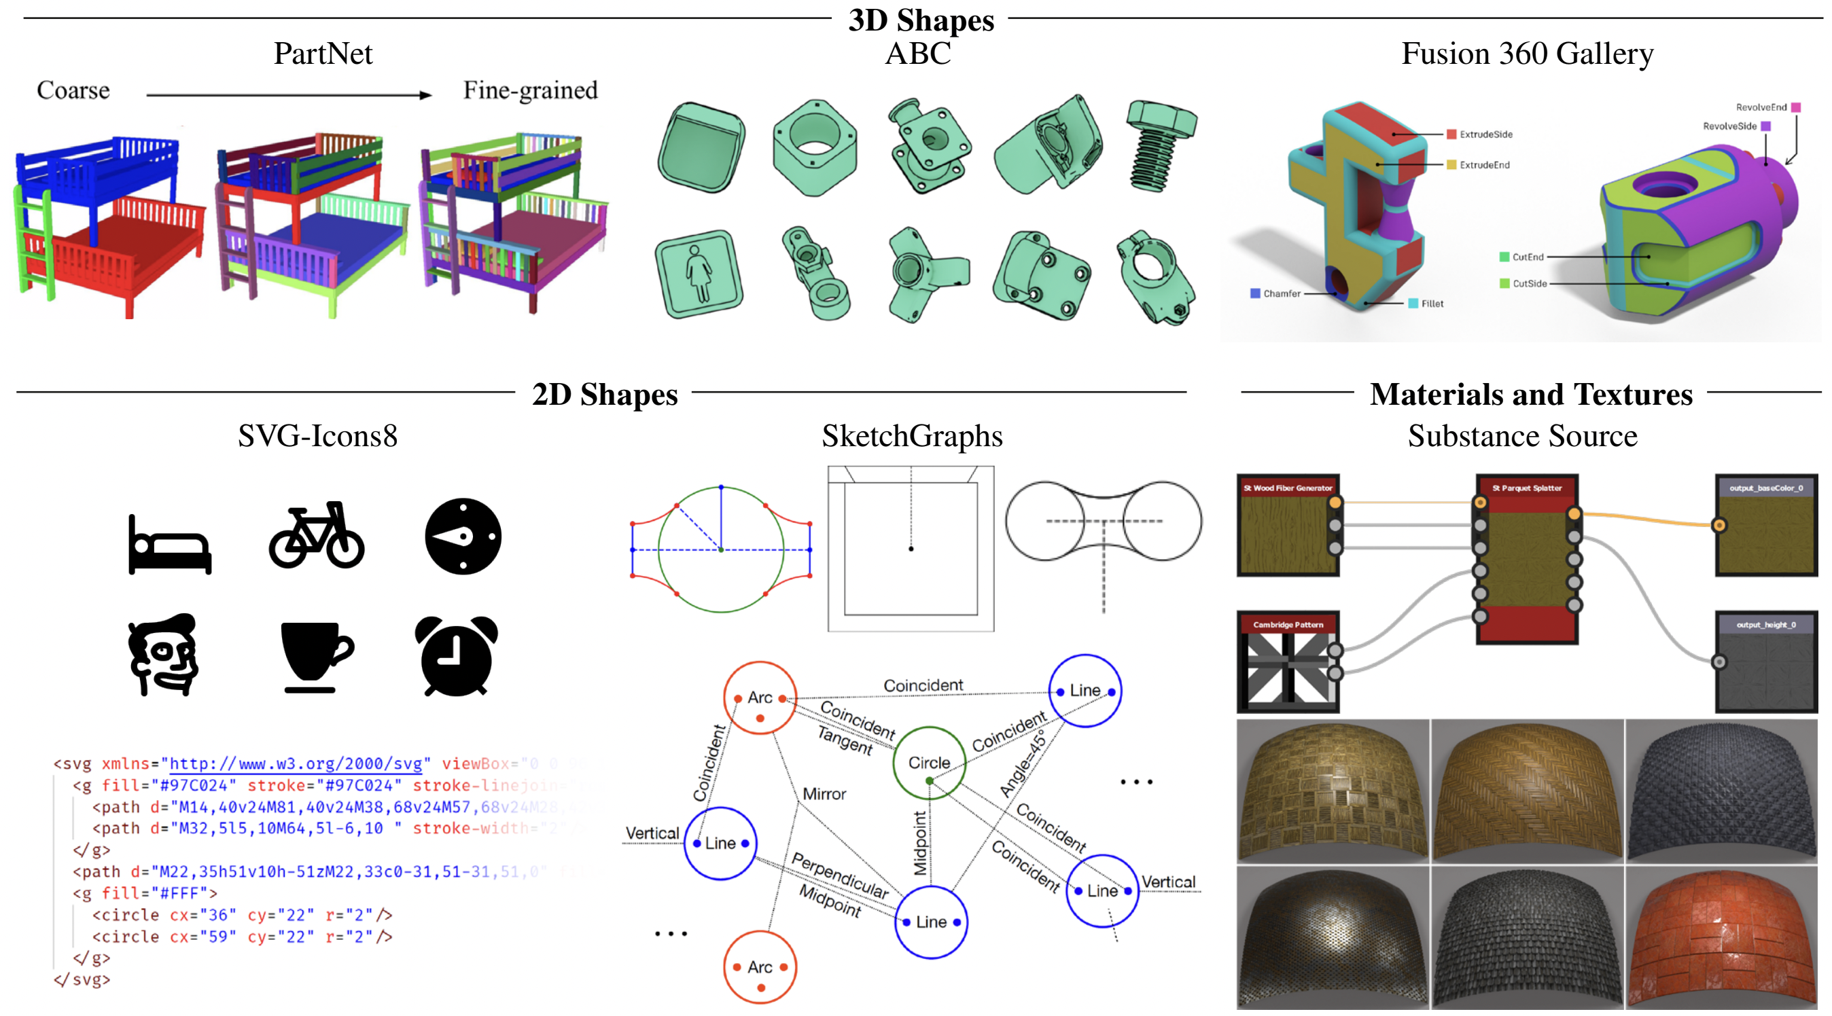


Beyond one single
RGB image
Chun-Hao Huang

Slide 2
So far
Theory and principles of diffusion models
2D image editing
  Editing one single image
  Identity preservation

Slide 3
This section
Editing “multiple images”
  in temporal dimension → videos
  in 2D image domain → image montage
  in 3D spatial domain → multi-views (without explicit 3D awareness)
Training-free / zero-shot setup
  Repurposing existing pretrained image diffusion model
Training setup
  Video diffusion model

Slide 4
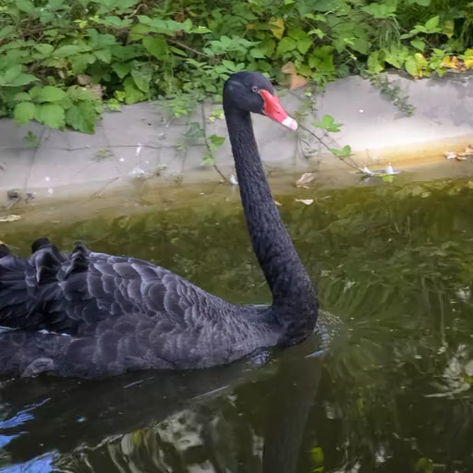
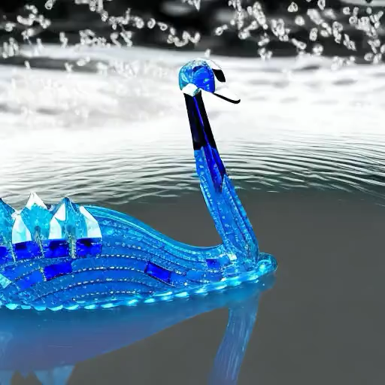
Individual editing – videos
input
per-frame edit
depth-conditioned SD

Slide 5
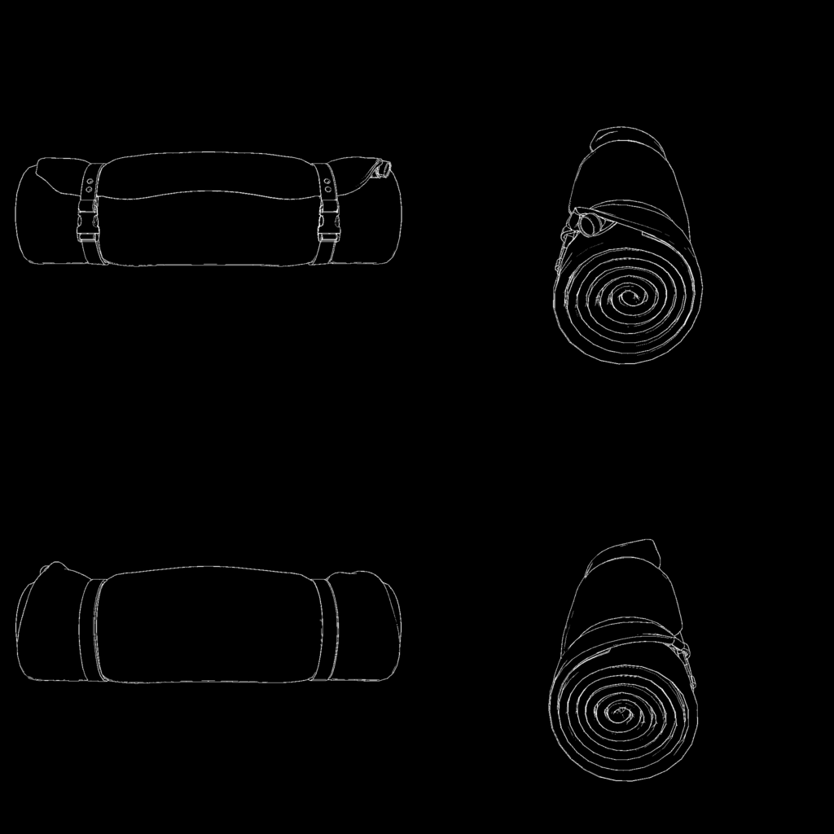
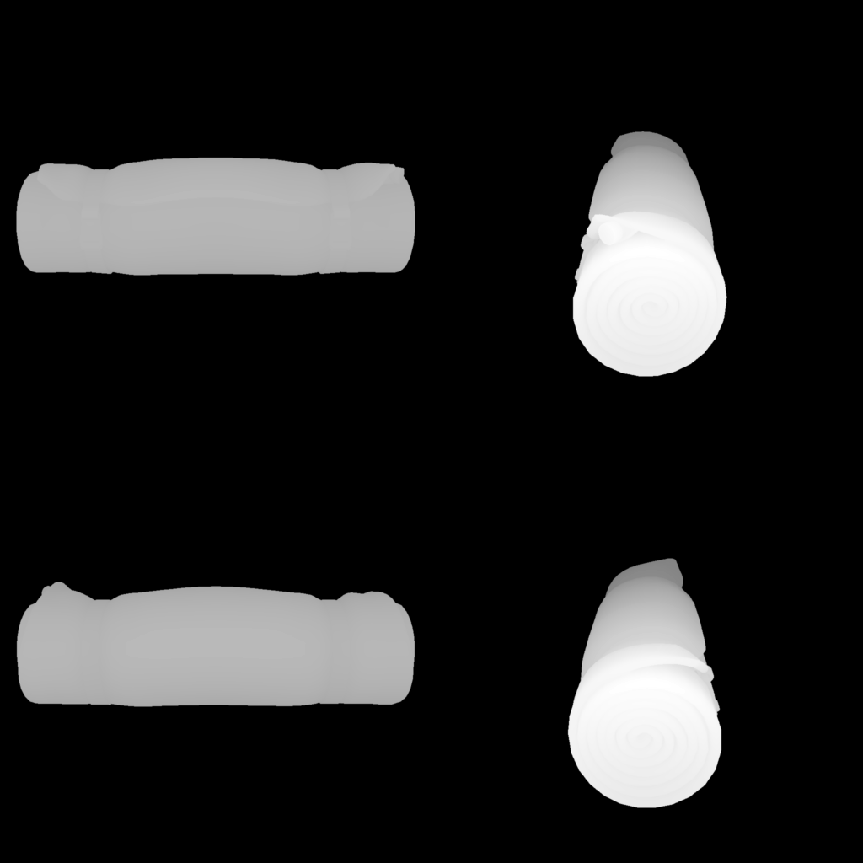


Individual editing – multiple views
input
input
per-view edits
Firefly structure match

Slide 6
Design space for consistency
If correspondences are known, synchronzing:
  Initial noise and/or noisy latents
  Features
Loss-guided denoising.
Repurposing self attention for cross-view, cross-frame attention.

Slide 7
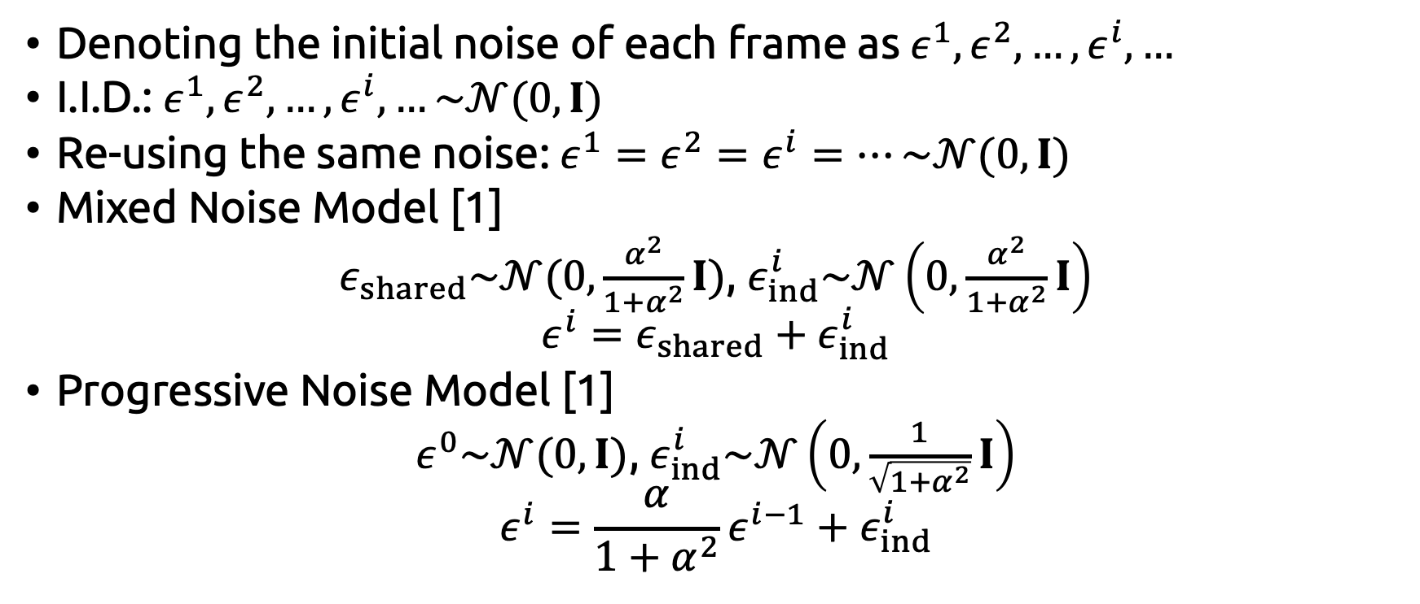
Noise model
Denoting the initial noise of each frame as $ε^{1},ε^{2},…,ε^{i},…$
I.I.D.: $ε^{1},ε^{2},…,ε^{i},…\sim 𝒩(0,I)$
Re-using the same noise: $ε^{1}=ε^{2}=ε^{i}=…\sim 𝒩(0,I)$
Mixed Noise Model [1]
$ε_{shared}\sim 𝒩(0,\frac{α^{2}}{1+α^{2}}I)$, $ε_{ind}^{i}\sim 𝒩\left(0,\frac{α^{2}}{1+α^{2}}I\right)$
$$ε^{i}=ε_{shared}+ε_{ind}^{i}$$
Progressive Noise Model [1]
$ε^{0}\sim 𝒩(0, I)$, $ε_{ind}^{i}\sim 𝒩\left(0,\frac{1}{\sqrt{1+α^{2}}}I\right)$
$$ε^{i}=\frac{α}{1+α^{2}}ε^{i−1}+ε_{ind}^{i}$$
[1] Ge et al., Preserve Your Own Correlation: A Noise Prior for Video Diffusion Models, ICCV’23

Slide 8
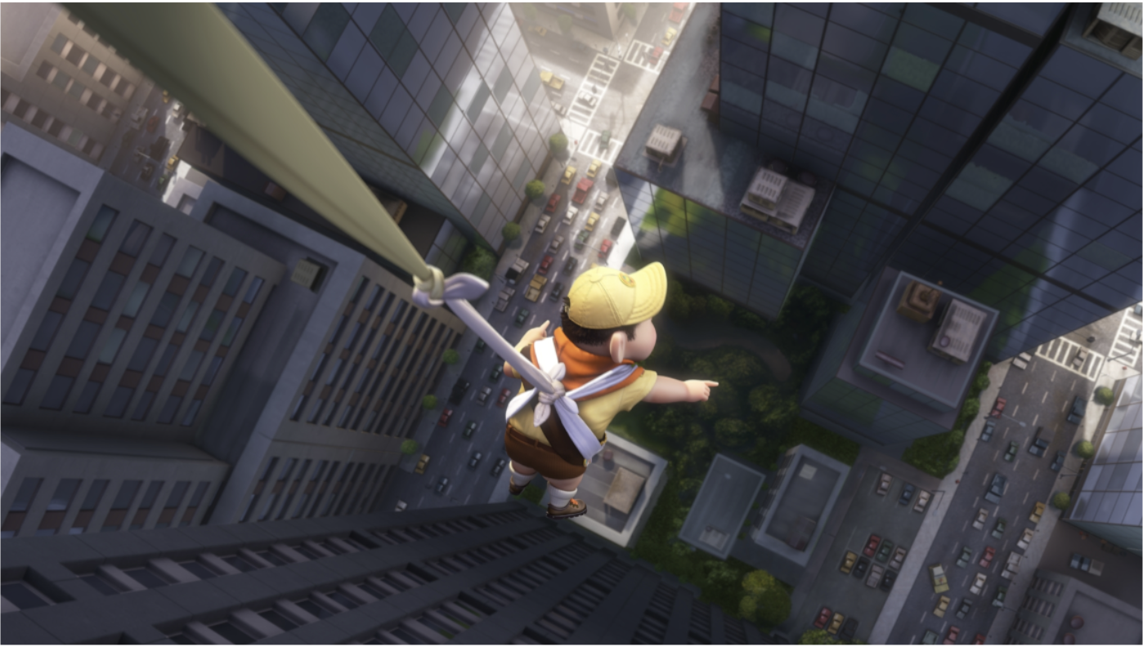
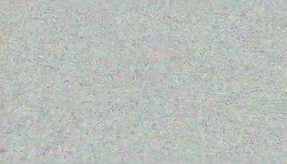
Correspondence-guided noise
Kass and Pesare, Coherent noise for non-photorealistic rendering, ToG’11

Slide 9
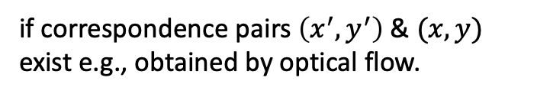
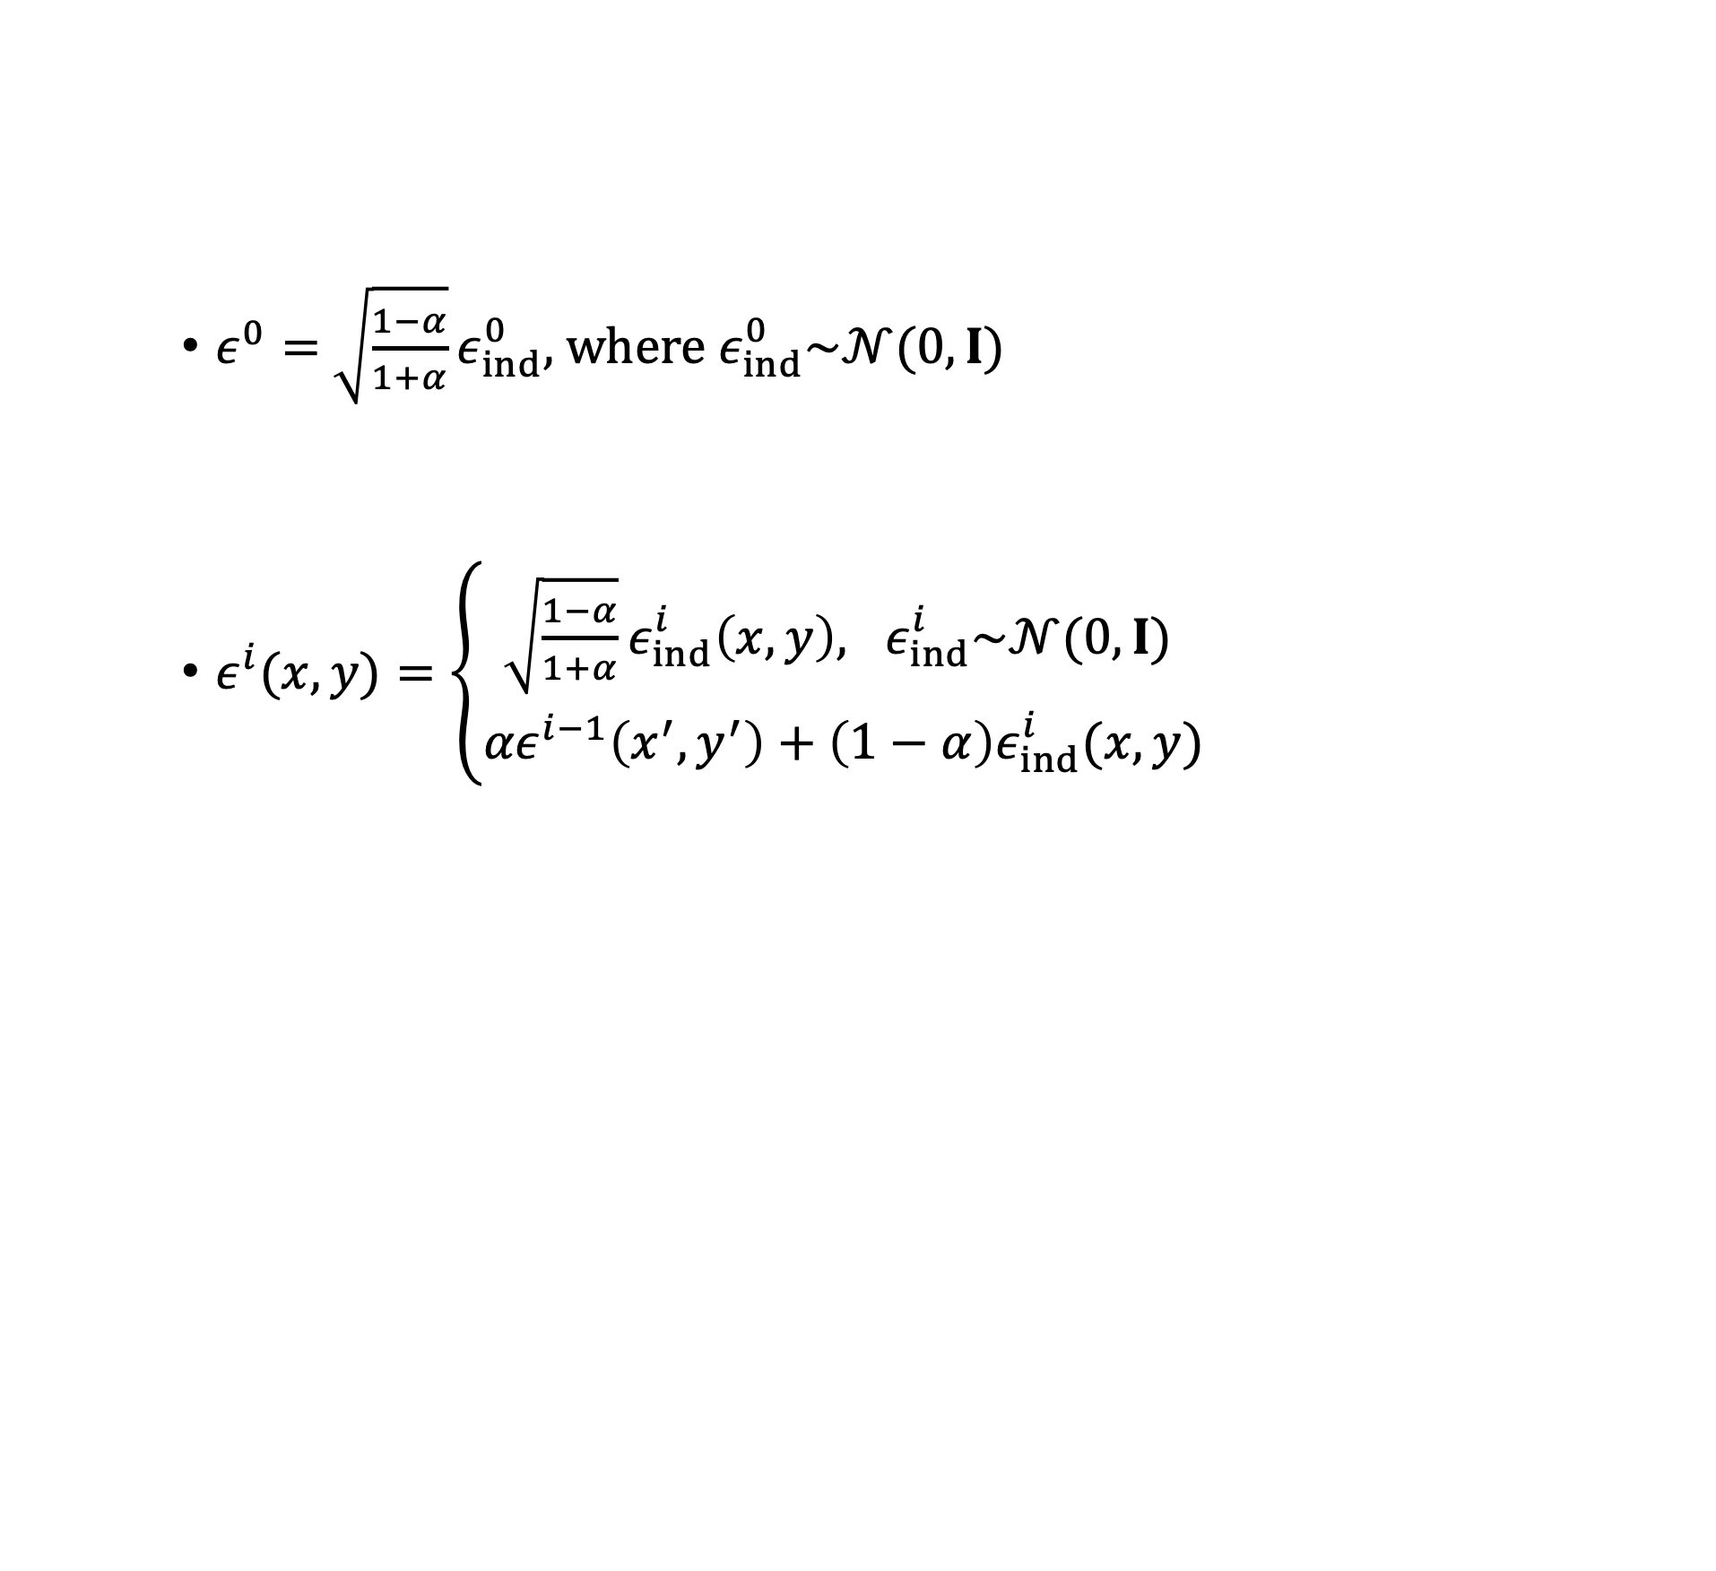
Correspondence-guided noise
$ε^{0}=$ $\sqrt{\frac{1−α}{1+α}}ε_{ind}^{0}$, where $ε_{ind}^{0}\sim 𝒩(0,I)$
$ε^{i}(x,y)=\left\{\begin{aligned}\sqrt{\frac{1−α}{1+α}}ε_{ind}^{i}\left(x,y\right), ε_{ind}^{i}\sim 𝒩(0,I) \\ {αε}^{i−1}\left(x^{′},y^{′}\right)+\left(1−α\right)ε_{ind}^{i}(x,y)\end{aligned}\right.$
disocclusion
if correspondence pairs $\left(x^{′},y^{′}\right)$ & $(x,y)$ exist e.g., obtained by optical flow.

Slide 10
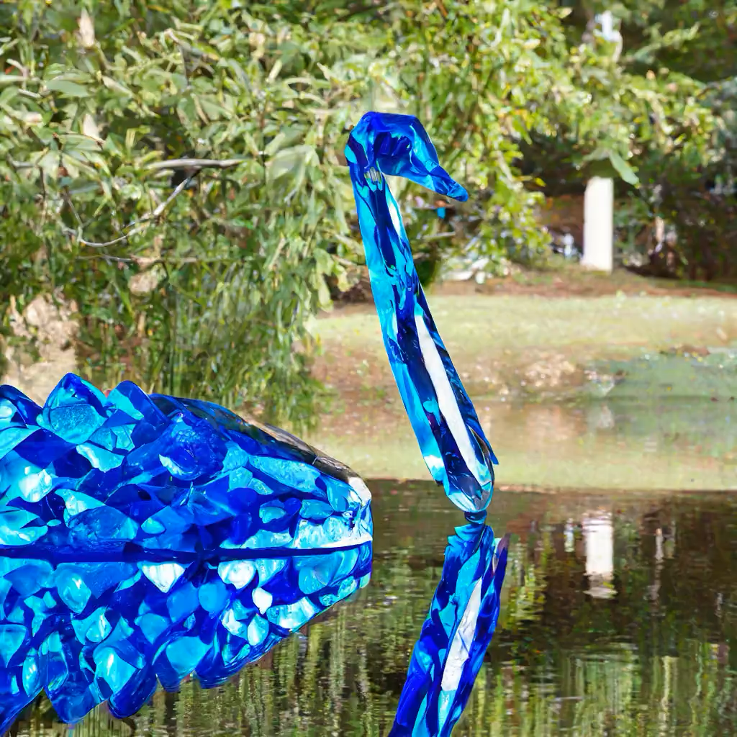
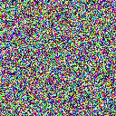

input
results using same rand initialized noise
correspondence guided noise
results using correspondence guided noise

Slide 11
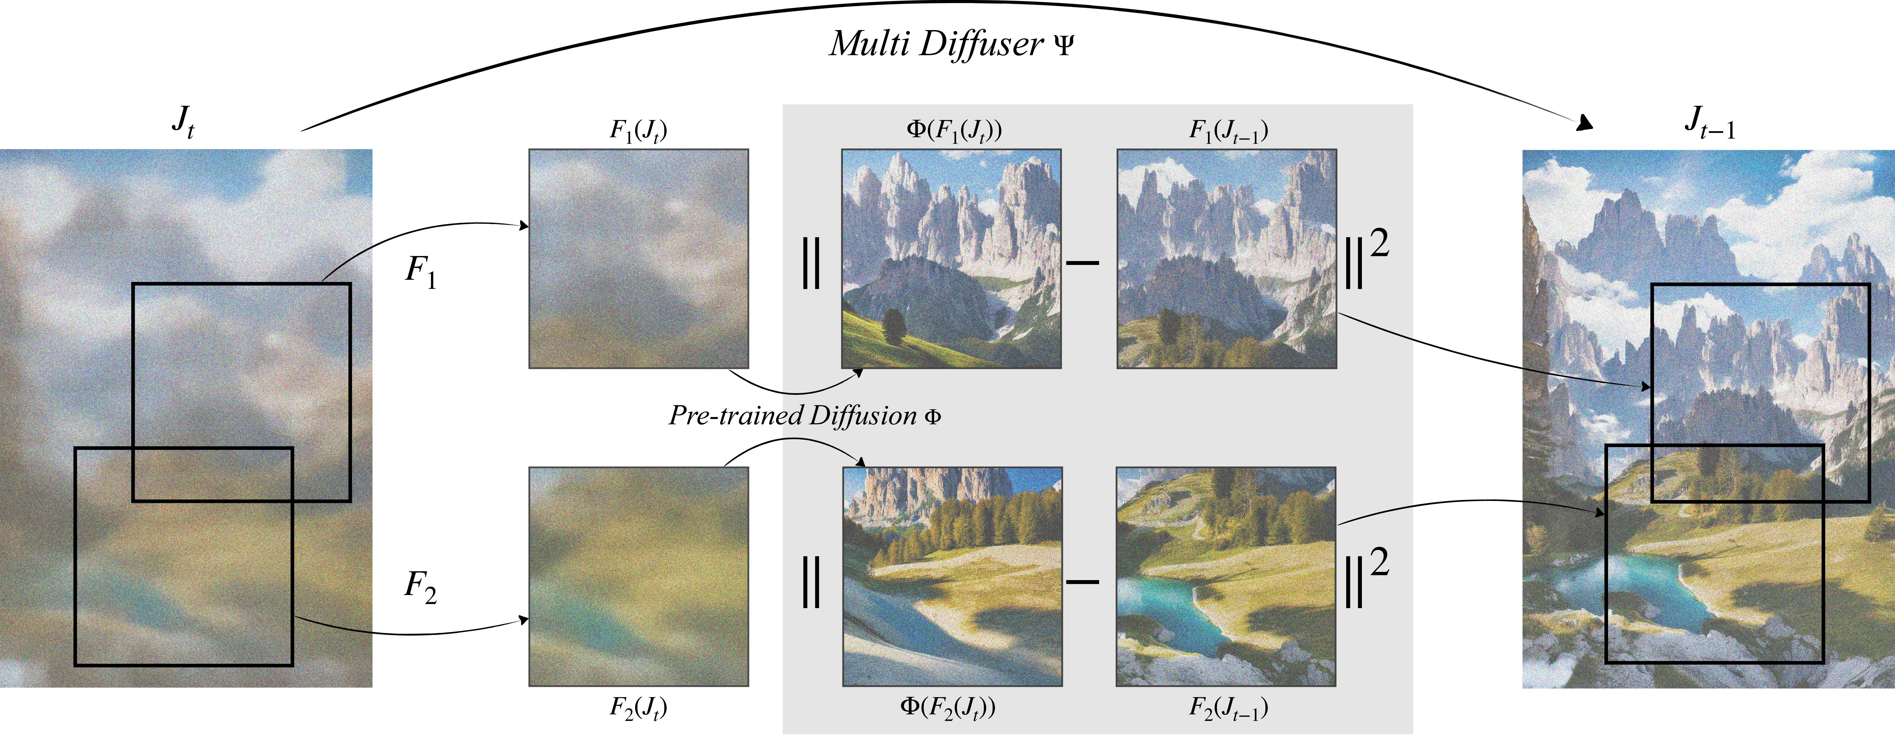
Synchronizing colors or latent features
Averaging noisy latents of the same pixels
Bar-Tal et al., MultiDiffusion: Fusing Diffusion Paths for Controlled Image Generation, ICML’23

Slide 12
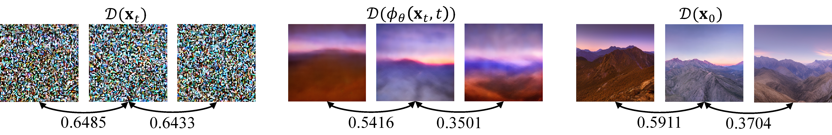
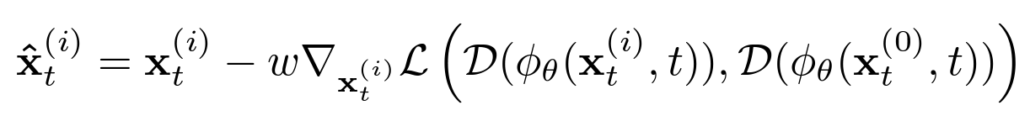

Loss-guided denoising
noisy image at t=45
predicted x0 at t=45
final denoised x0
Loss $ℒ$: LPIPS score on the predicted denoised x0
Lee et al., SyncDiffusion: Coherent Montage via Synchronized Joint Diffusions, NeurIPS’23

Slide 13


without loss-guided denoising
with loss-guided denoising

Slide 14

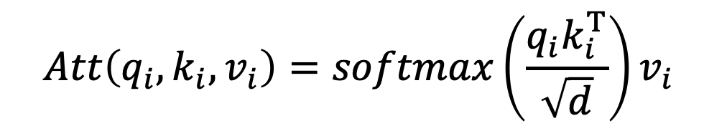

Self-attention in UNet
$$Att\left(q_{i}, k_{i}, v_{i}\right)=softmax\left(\frac{q_{i}k_{i}^{T}}{\sqrt{d}}\right)v_{i}$$
query $q_{i}$
key $k_{i}$, value $v_{i}$
Independent generation: each sample in the batch attends to only itself.
B
B
[B, seqlen, #head, dim]
[B, seqlen, #head, dim]

Slide 15
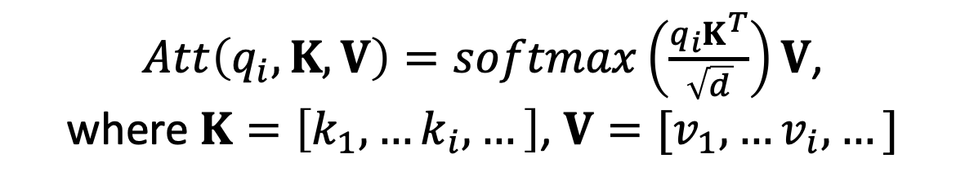

Repurposing self attention
$Att\left(q_{i},K, V\right)=softmax\left(\frac{q_{i}K^{T}}{\sqrt{d}}\right)V$,
where $K=\left[k_{1},…k_{i},…\right]$, $V=[v_{1},…v_{i},…]$
query $q_{i}$
key $K$, value $V$
Batch generation: each sample attends to every samples.
B
B
[B, seqlen, #head, dim]
[B, seqlen, #head, dim]

Slide 16
Pseudo code
key, value
key, value
bs = k.shape[0]
k, v = (t.reshape(1, -1, attn.heads,attn.dim_head) for t in (k, v))
k = k.expand(bs, -1, -1, -1)
v = v.expand(bs, -1, -1, -1)
key, value
B
[B, seqlen, #head, dim]
[1, B*seqlen, #head, dim]
[B, B*seqlen, #head, dim]

Slide 17
Training-free/zero-shot video stylization
Each frame attends to pre-defined “keyframes”
  Pix2Video [1]: keyframes = [frame 1, frame t-1]
  FateZero [2]: keyframes = [middle frame]
  Text2Video-Zero [3]: keyframes = [frame 1]
query
key, value
frame t
frame t
keyframe #1
keyframe #2
[1] Ceylan et al., Pix2Video: Video Editing using Image Diffusion, ICCV’23
[2] Qi et al., FateZero: Fusing Attentions for Zero-shot Text-based Video Editing, ICCV’23
[3] Khachatryan et al., Text2Video-Zero: Text-to-Image Diffusion Models are Zero-Shot Video Generators, ICCV’23

Slide 18
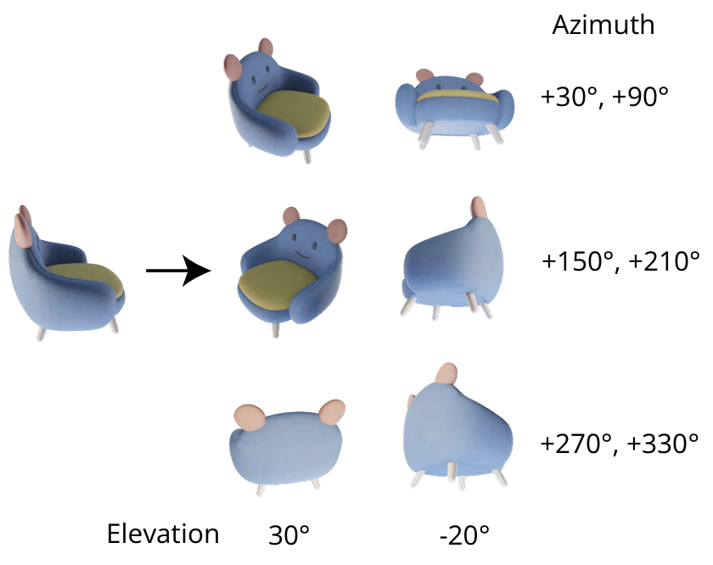
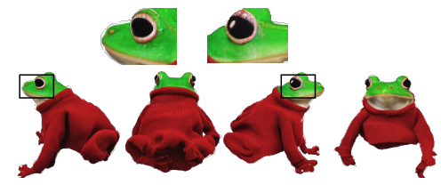
Applied on multi-view generation
Stacking views into an image grid: a simple yet effective way of repurposing self-attention as cross-view attention.
Tsalicoglou et al., Textmesh: Generation of realistic 3d meshes from text prompts, arXiv’23
Shi et al., Zero123++: a Single Image to Consistent Multi-view Diffusion Base Model, arXiv’23

Slide 19



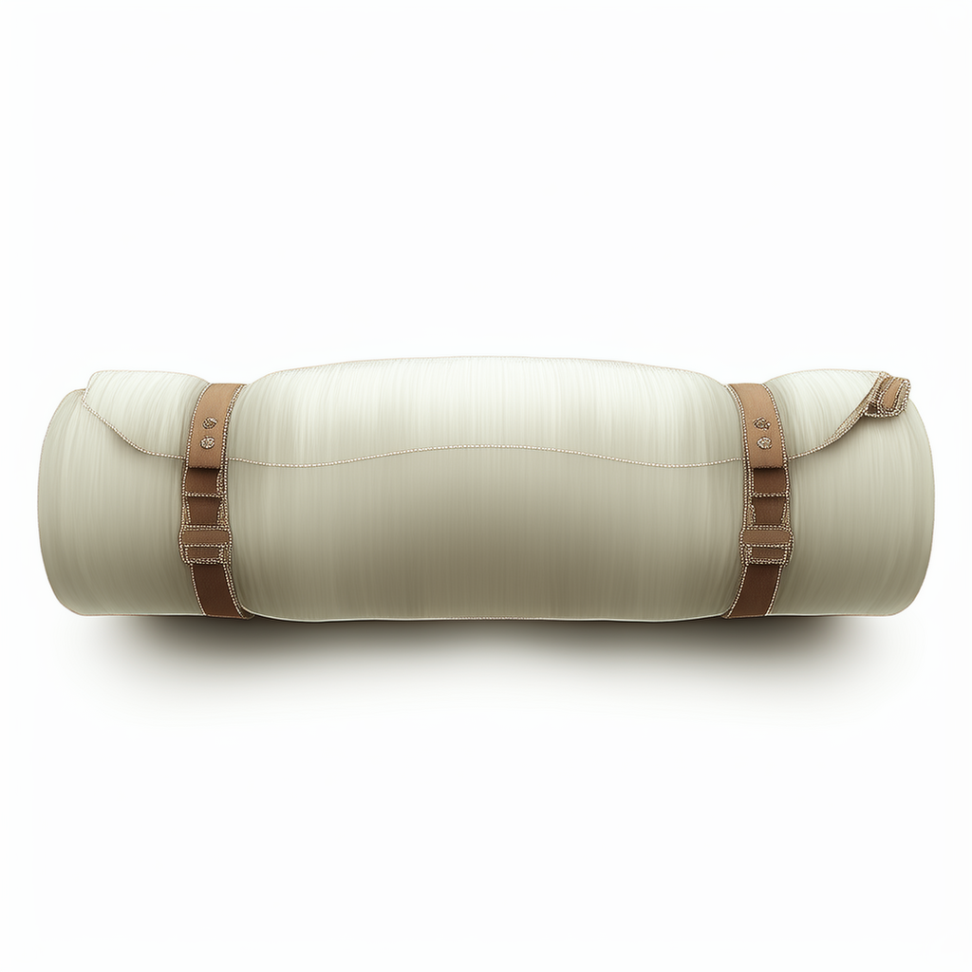
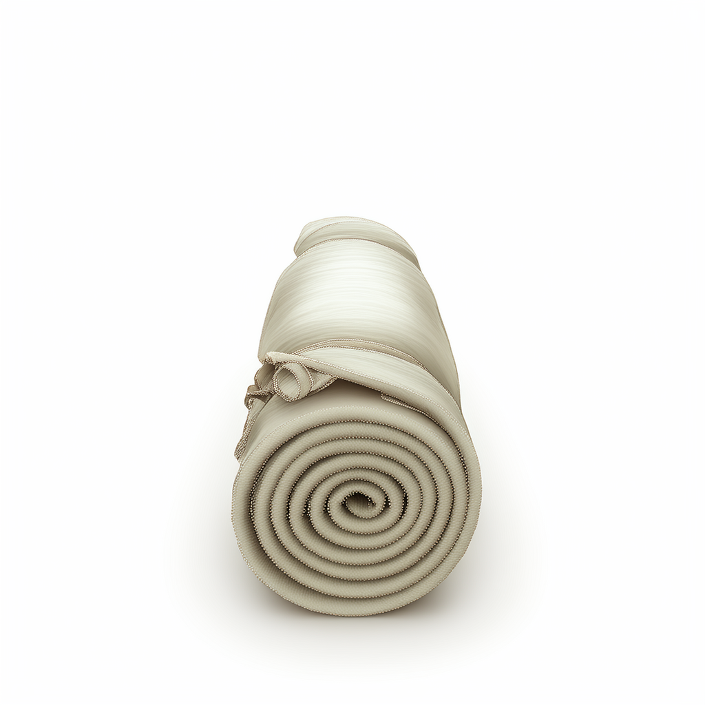
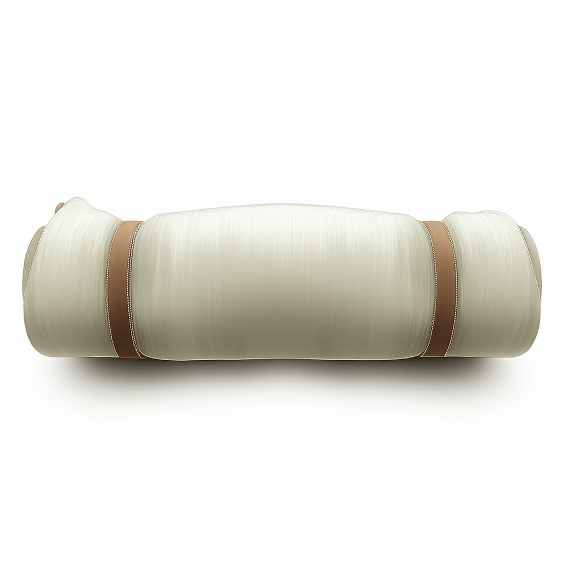
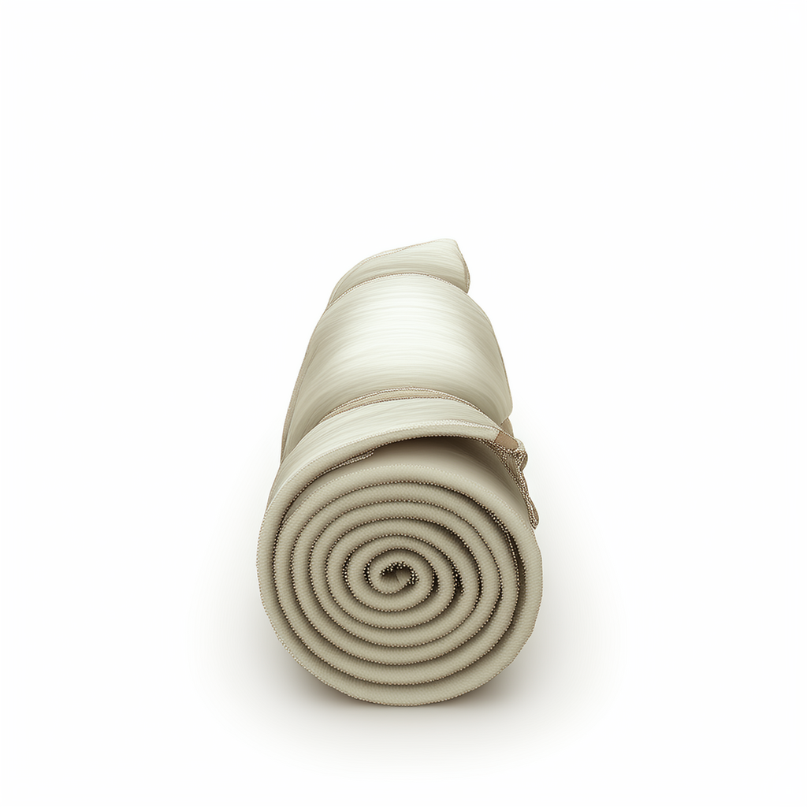
multi-view
independent
grid-view
batch
Notes:
time 512x512
time 1024x1024

Slide 20
Video diffusion model
Adding a temporal attention layer after spatial cross attention
…
…
self attention
cross attention
temporal attention

Slide 21
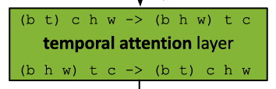
Inflated temporal attention layer
hidden_states = \
hidden_states.permute(0, 3, 4, 2, 1).reshape(batch_size * height * width, num_frames, channel)
# 2. Blocks
for block in self.transformer_blocks:
hidden_states = block(
hidden_states,
encoder_hidden_states=encoder_hidden_states,
timestep=timestep,
cross_attention_kwargs=cross_attention_kwargs,
class_labels=class_labels,
)
# 3. Output
hidden_states = self.proj_out(hidden_states)
hidden_states = (
hidden_states[None, None, :]
.reshape(batch_size, height, width, num_frames, channel)
.permute(0, 3, 4, 1, 2)
.contiguous()
)
hidden_states = hidden_states.reshape(batch_frames, channel, height, width)
Blattmann et al., Align your Latents: High-Resolution Video Synthesis with Latent Diffusion Models, CVPR’23
Blattmann et al., Stable Video Diffusion: Scaling Latent Video Diffusion Models to Large Datasets, arXiv’23
Guo et al., AnimateDiff: Animate Your Personalized Text-to-Image Diffusion Models without Specific Tuning, ICLR’24

Slide 22
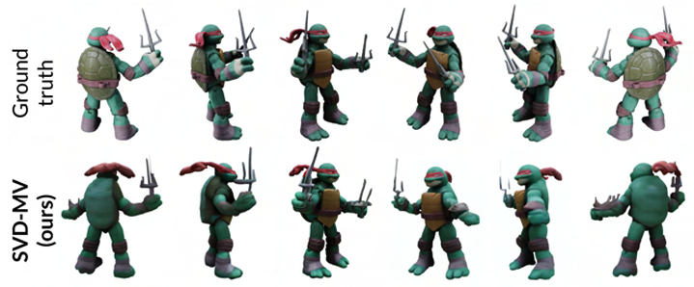
Applied on multi-view generation
Generating 360 turn-table videos of 3D objects
Blattmann et al., Stable Video Diffusion: Scaling Latent Video Diffusion Models to Large Datasets, arXiv’23

