Slide 1



Diffusion Models for Visual Computing
Niloy Mitra, Daniel Cohen-Or,
Chun-Hao Huang, Duygu Ceylan, Paul Guerrero
Part 4: Personalization & Editing

Slide 2
Presentation Schedule
9:00 – 9:30 | Introduction to Diffusion Models
9:30 – 10:00 | Guidance and Conditional Sampling
10:00 – 10:30 | Features, Latent Space, Image Priors
10:30 – 11:00 | Break
11:00 – 11:30 | Personalization and Editing
11:30 – 12:00 | Beyond RGB Images
12:00 – 12:30 | Diffusion Models in Other Domains

Slide 3
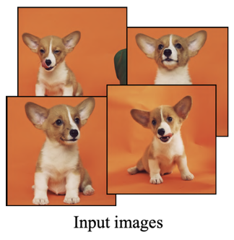
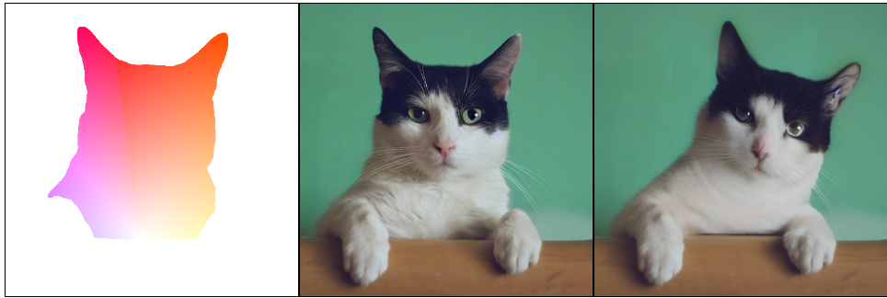
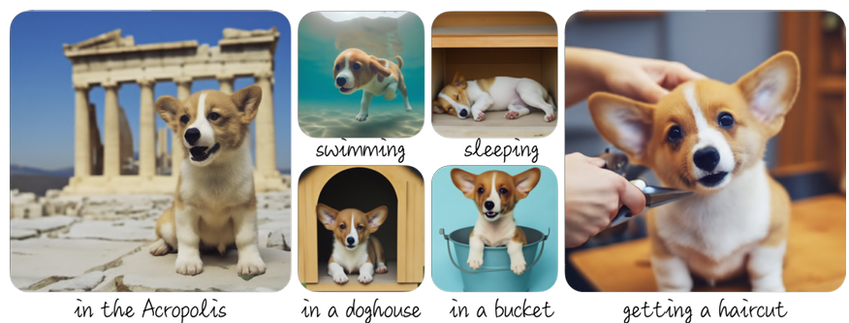
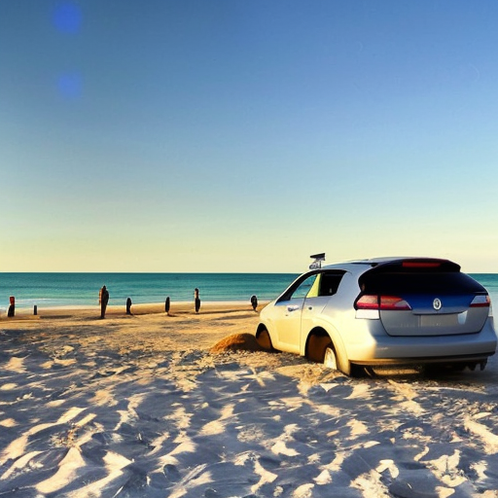
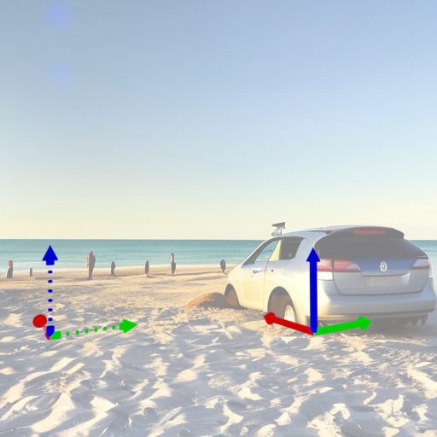
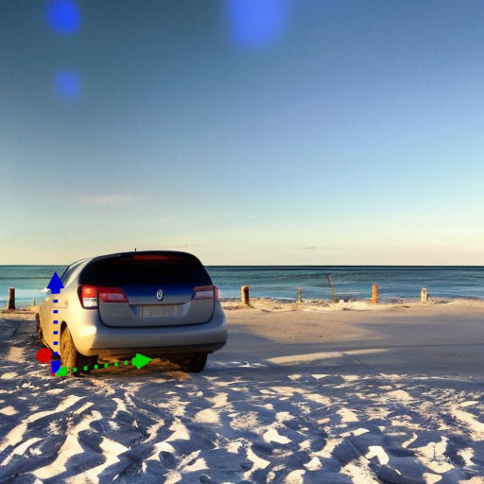
Personalization
Editing
Motion Guidance: Diffusion-Based Image Editing with Differentiable Motion Estimators, Geng and Owens, ICLR 2024
DreamBooth: Fine Tuning Text-to-Image Diffusion Models for Subject-Driven Generation,
Ruiz et al., CVPR 2023
Diffusion Handles: Enabling 3D Edits for Diffusion Models by Lifting Activations to 3D
Pandey et al., CVPR 2024

Slide 4
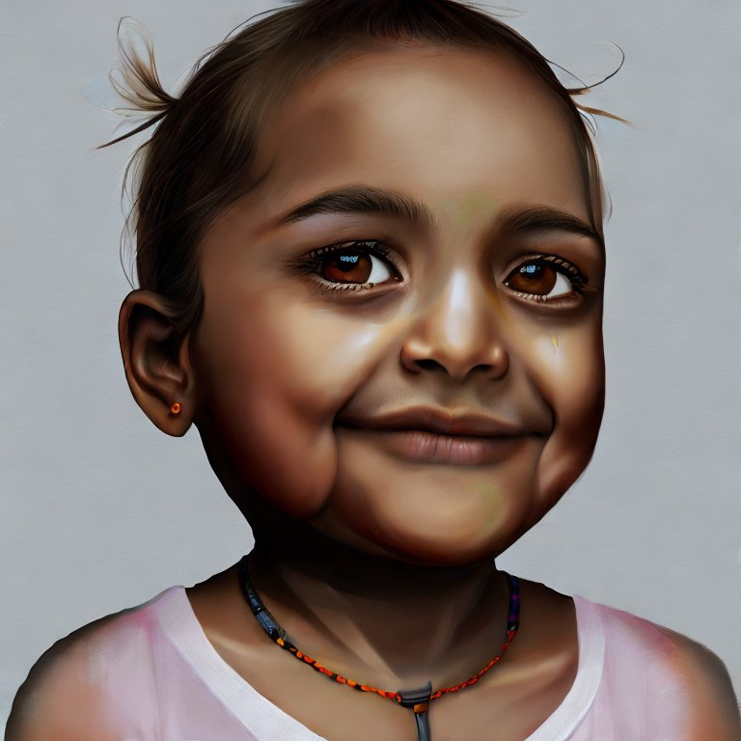
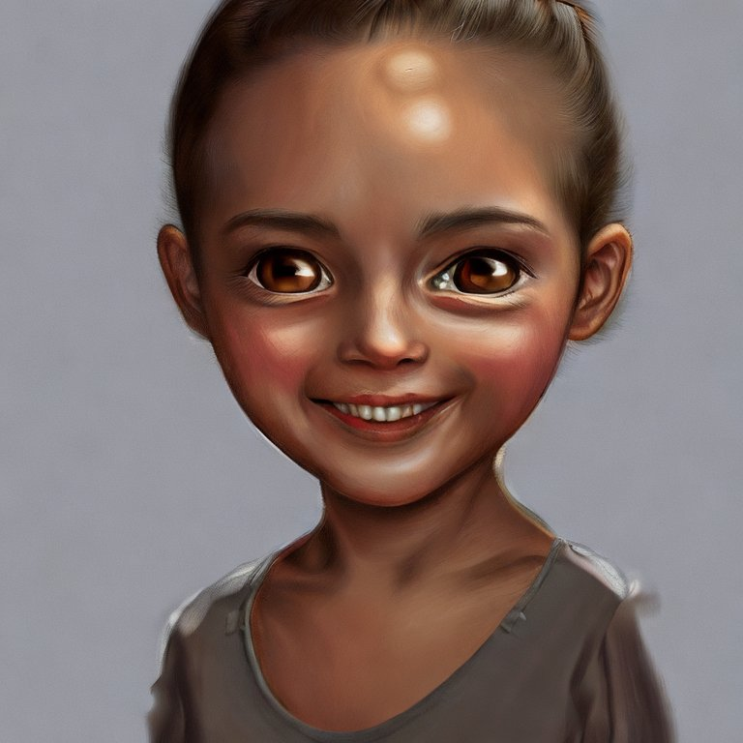
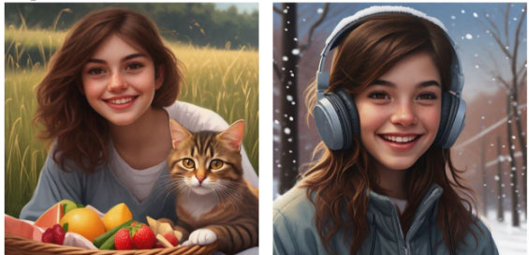
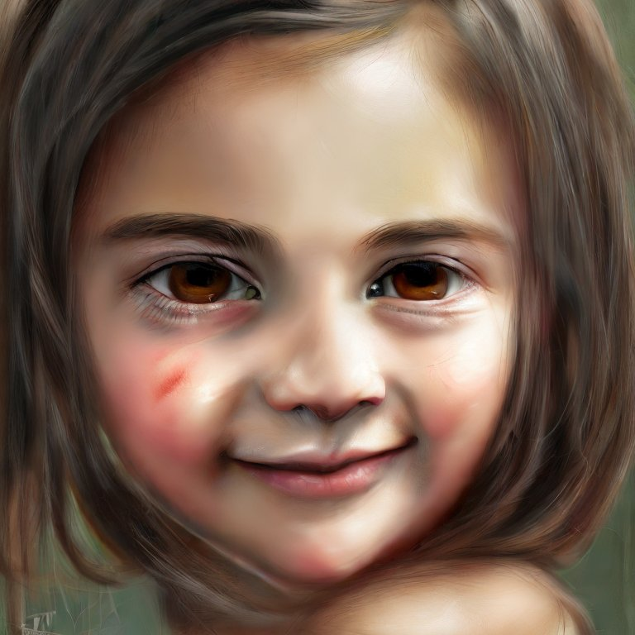
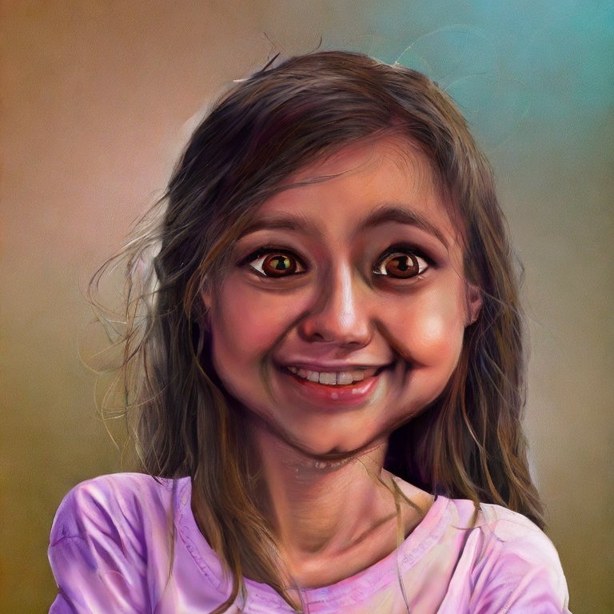
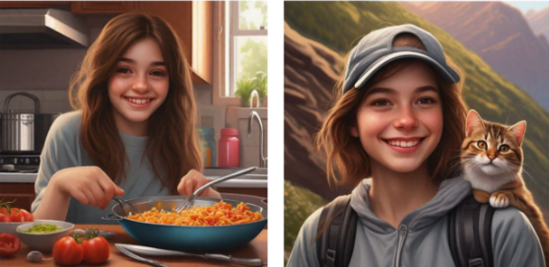
Personalization
“a hyper-realistic digital painting of a happy girl, with brown eyes”
Without Personalization
With Personalization
Generated with StabelDiffusion 2.1
ConsiStory: Training-Free Consistent Text-to-Image Generation
Tewel et al., ArXiv Feb. 2024

Slide 5
Personalization
With Personalization
Same subject in different settings.
Personalization:
Generative Model
+ Identity Preservation
ConsiStory: Training-Free Consistent Text-to-Image Generation
Tewel et al., ArXiv Feb. 2024

Slide 6

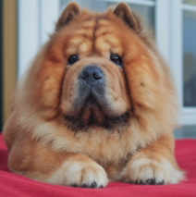


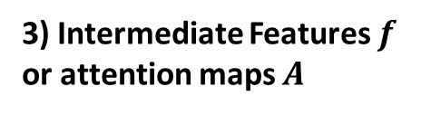
Identity Preservation
How can we represent the identity of a subject?
These are the most popular approaches:
1) Condition (Text) Embeddings $y$
Denoiser
2) Weights $θ$
3) Intermediate Features $f$ or attention maps $A$

Slide 7
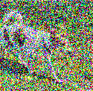
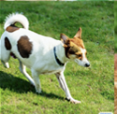
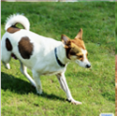
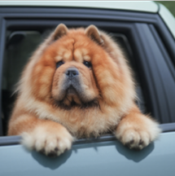
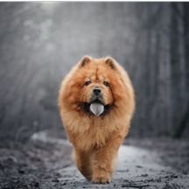
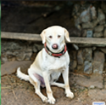
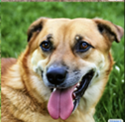


ID Preservation by Fine-Tuning Denoiser Weights
Fine-tuning
[V] is chosen to be a string that is encoded into rare token(s) by the tokenizer.
Regularization
“A [V] dog”
“A dog”
Denoiser
Denoiser
Weights $θ$
Loss
Weights $θ$
Loss
3-5 example images showing the identity.
Regularization data can be generated by the original, non-finetuned model, or can come from a large dataset.
DreamBooth: Fine Tuning Text-to-Image Diffusion Models for Subject-Driven Generation,
Ruiz et al., CVPR 2023
Notes:
Rare token: token that is used infrequently

Slide 8
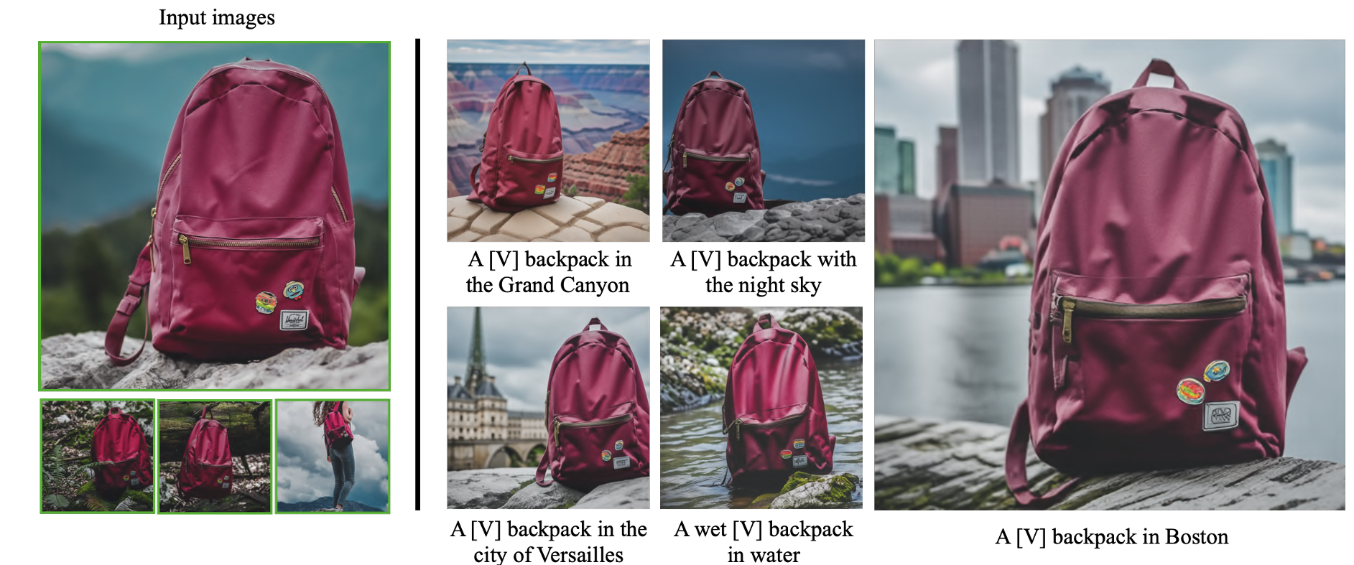
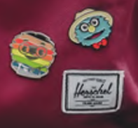
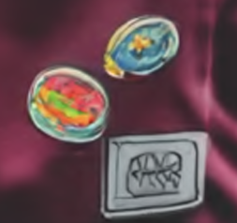
ID Preservation by Fine-Tuning Denoiser Weights
DreamBooth: Fine Tuning Text-to-Image Diffusion Models for Subject-Driven Generation,
Ruiz et al., CVPR 2023
Notes:
Rare token: token that is used infrequently

Slide 9
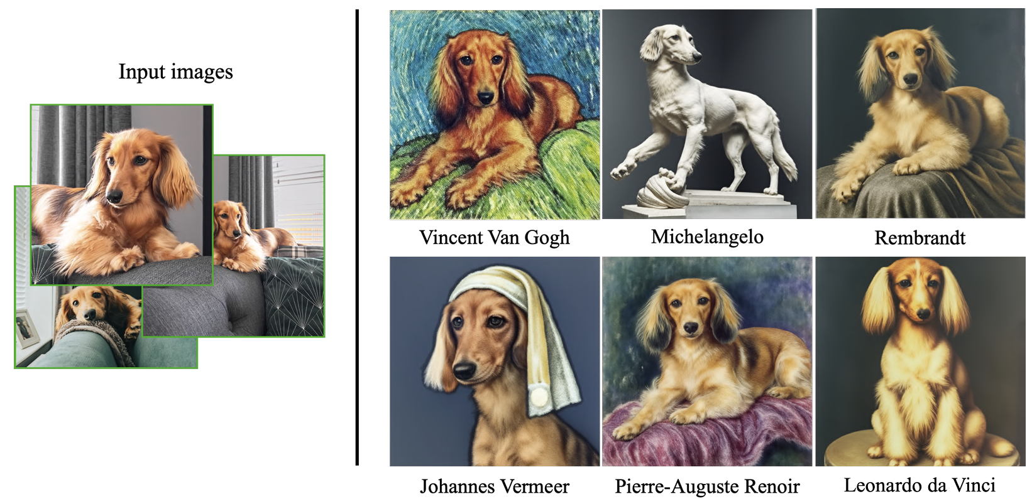
ID Preservation by Fine-Tuning Denoiser Weights
DreamBooth: Fine Tuning Text-to-Image Diffusion Models for Subject-Driven Generation,
Ruiz et al., CVPR 2023
Notes:
Rare token: token that is used infrequently

Slide 10
ID Preservation by Fine-Tuning Text Embeddings
Fine-tuning
More specifically, the embedding of [V]
is optimized.
“A [V] dog”
Denoiser
Loss
An Image is Worth One Word: Personalizing Text-to-Image Generation using Textual Inversion,
Gal et al., ICLR 2023

Slide 11
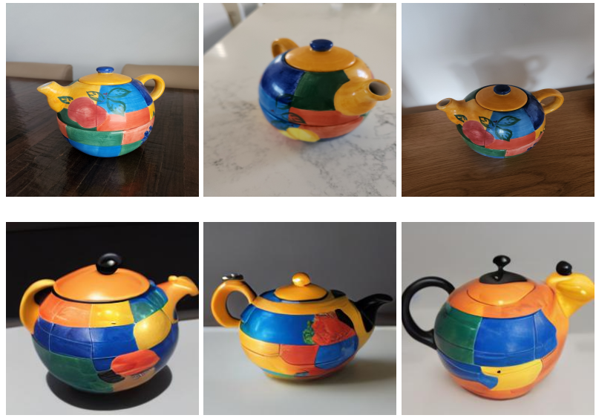

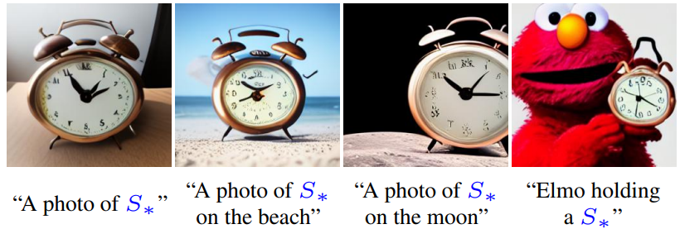
ID Preservation by Fine-Tuning Text Embeddings
Compared to fine-tuning denoiser weights:
Only the optimized embedding needs to be stored, not the full denoiser weights.
ID preservation is a bit weaker.
Input Images
“A photo of [V]”
An Image is Worth One Word: Personalizing Text-to-Image Generation using Textual Inversion,
Gal et al., ICLR 2023
Notes:
There is some identity preservation, but its not perfect.

Slide 12
Fine-Tuning Text Embeddings & Cross-Att. Weights
Fine-tuning
“A [V] dog”
“A [V] dog”
Token Encoder
Denoiser
K
V
Cross-Attention
with Weights
K,V,Q
Loss
Q
Denoiser
Multi-Concept Customization of Text-to-Image Diffusion, Kumari et al., CVPR 2023
Key-Locked Rank One Editing for Text-to-Image Personalization, Tewel et al., SIGGRAPH 2023
Notes:
Cross-Attention is done in several layers of the denoiser, just showing one here.

Slide 13
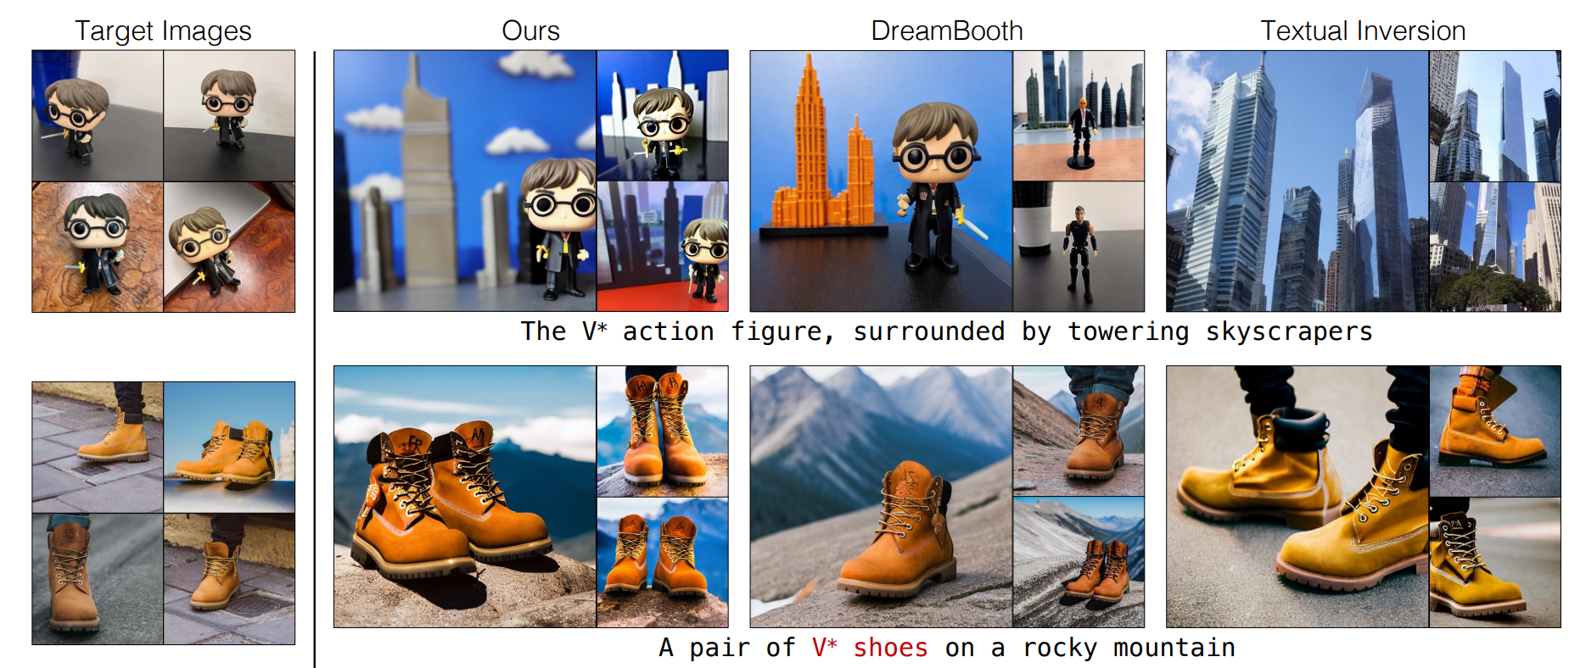
Fine-Tuning Text Embeddings & Cross-Att. Weights
Fine-tuning text embeddings, keys and values.
ID preservation is close to tuning denoiser weights, while requiring less storage.
Text Emb., Key, Val.
Denoiser Weights
Text Embedding
Multi-Concept Customization of Text-to-Image Diffusion, Kumari et al., CVPR 2023
Notes:
Gets close to the ID preservation performance of DreamBooth, while requiring less storage for weights (only optimized text embedding and K,V weights).

Slide 14
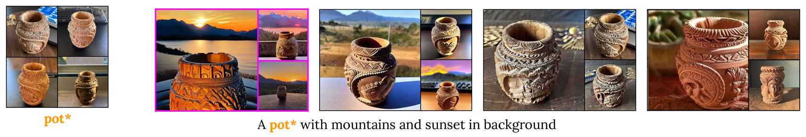
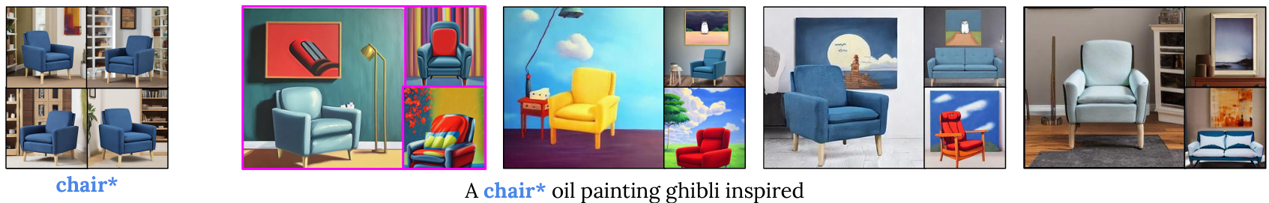
Fine-Tuning Text Embeddings & Cross-Att. Weights
Fine-tuning text embeddings and values only.
ID preservation is slightly worse than tuning denoiser weights but follows the prompt better.
Text Emb., Key
Text Emb., Key, Val.
Denoiser Weights
Text Embedding
Key-Locked Rank One Editing for Text-to-Image Personalization, Tewel et al., SIGGRAPH 2023
Notes:
Not optimizing the key avoids a problem where the attention map for the personalized object takes over the whole image, thus decreasing prompt adherence (each pixel block pays attention mostly to the personalized object, not the other parts of the text)

Slide 15
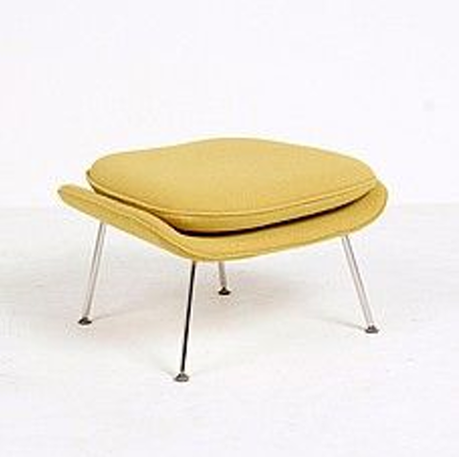



ID Preservation with Learned Condition Encoders
Motivation: avoid the need to fine-tune for each object identity.
“A dog”
Token Encoder
Large Image Dataset
Image Encoder
…
Weights $φ$
Condition Encoder
Weights $ψ$
Loss
Denoiser
Weights $θ$
FastComposer: Tuning-Free Multi-Subject Image Generation with Localized Attention,
Gal et al., ArXiv May 2023
BLIP-Diffusion: Pre-trained Subject Representation for Controllable Text-to-Image Generation and Editing,
Li et al., NeurIPS 2024
Notes:
Image that is encoded can either be the same image as the ground truth for the loss, or same subject composited onto a different background (with standard image compositing tools).

Slide 16
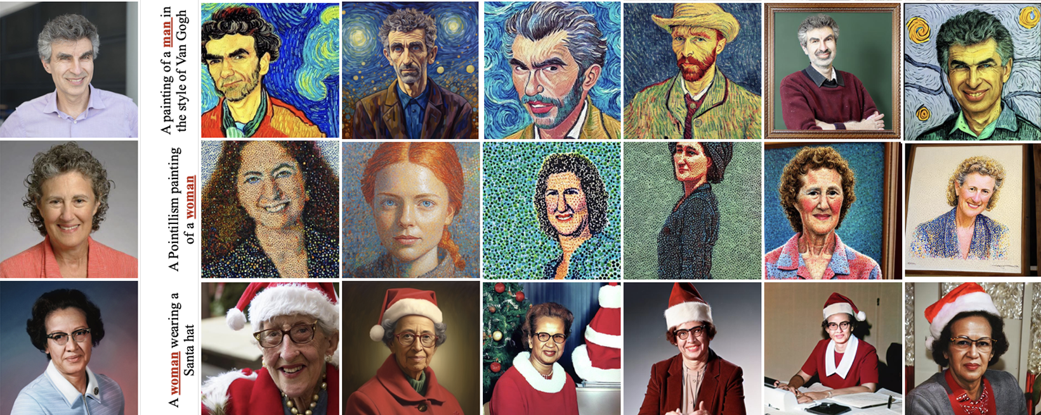
ID Preservation with Learned Condition Encoders
Text
Embedding
Denoiser
Weights
Text Emb.,
Key, Val.
Condition
Encoder
FastComposer: Tuning-Free Multi-Subject Image Generation with Localized Attention,
Gal et al., ArXiv May 2023

Slide 17
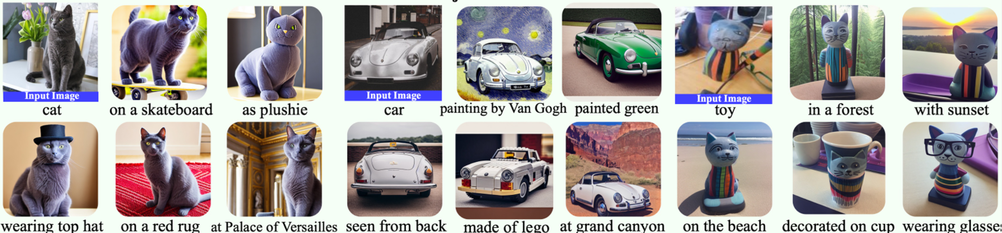
ID Preservation with Learned Condition Encoders
BLIP-Diffusion: Pre-trained Subject Representation for Controllable Text-to-Image Generation and Editing,
Li et al., NeurIPS 2024

Slide 18
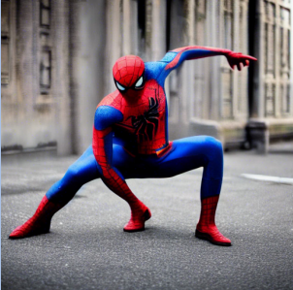

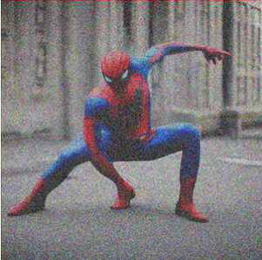
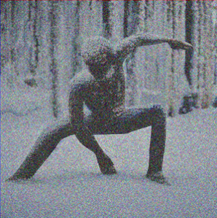
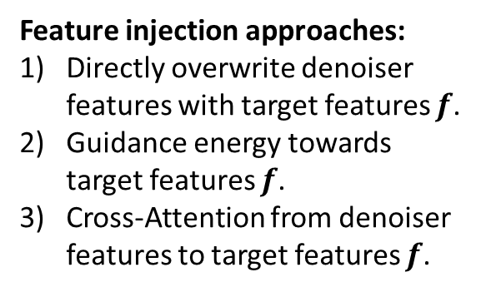
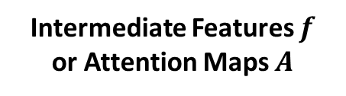
ID Preservation through Intermediate Features
Non-Generated
Image
“A photo of spiderman”
Inversion
Denoiser
same noise
Intermediate Features $f$
or Attention Maps $A$
Feature injection approaches:
Directly overwrite denoiser
features with target features $f$.
Guidance energy towards
target features $f$.
Cross-Attention from denoiser
features to target features $f$.
Denoiser
“A photo of a statue
in the snow”
Plug-and-Play Diffusion Features for Text-Driven Image-to-Image Translation,
Tumanyan et al., CVPR 2023
Diffusion Self-Guidance for Controllable Image Generation,
Epstein et al., NeurIPS 2023
MasaCtrl: Tuning-Free Mutual Self-Attention Control for Consistent Image Synthesis and Editing, Cao et al., ICCV 2023
Notes:
Intermediate features can also include attention maps.
Feature injection in the denoiser can be performed by:
1) Directly overwriting features (Plug-and-Play Diffusion).
2) Adding a guidance energy that guides the diffusion process towards these features. (Diffusion Self-Guidance, Diffusion Handles).
3) Modifying the Self-Attention layers to attend to these features (effectively making them cross-attention layers) (MasaCtrl, MagicFixup).
(Also using video-like attention from target image to a source image containing the subject identity can be counted in this category – more on this in the editing part)

Slide 19
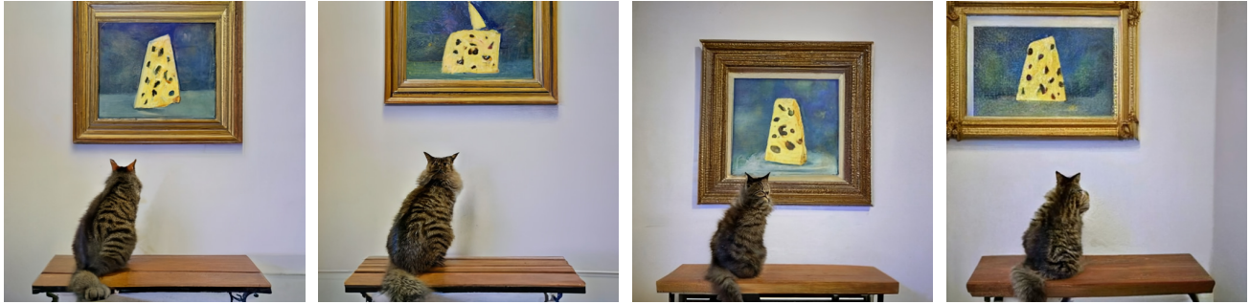
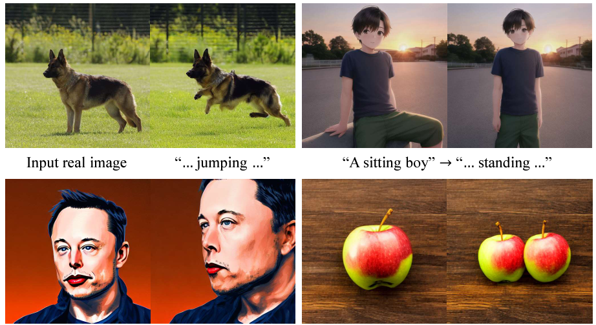
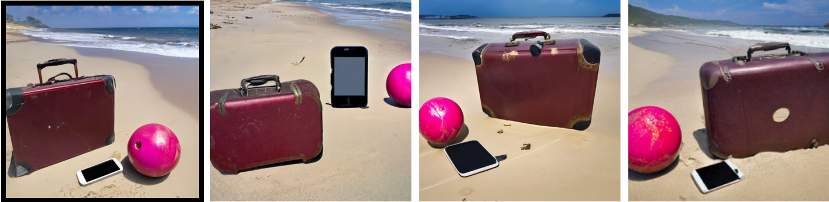

ID Preservation through Intermediate Features
No training or fine-tuning needed.
Intermediate features entangle identity with location and context, thus it requires additional work to allow for large changes in locations & contexts.
Guidance energy towards target features $f$.
Cross-Attention from denoiser features to target features $f$.
Diffusion Self-Guidance for Controllable Image Generation,
Epstein et al., NeurIPS 2023
MasaCtrl: Tuning-Free Mutual Self-Attention Control for Consistent Image Synthesis and Editing, Cao et al., ICCV 2023
Notes:
This form of identity preservation is used more often in the context of editing since it can easily be used to preserve as much of the input image as needed.
You can see that the results already show a form of image editing.
So lets continue with image editing methods next.

Slide 20
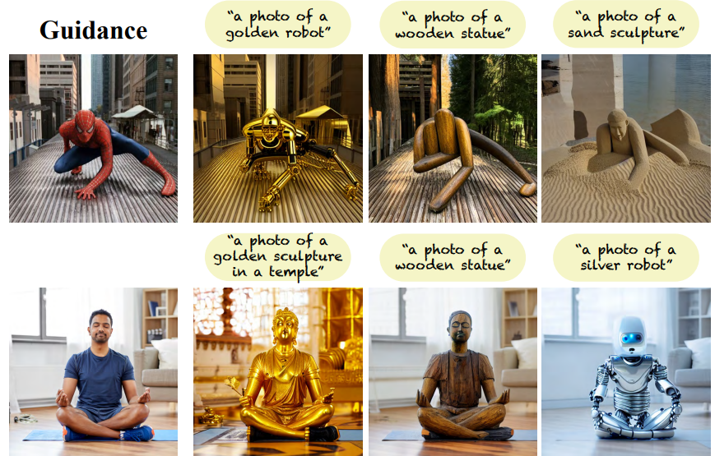
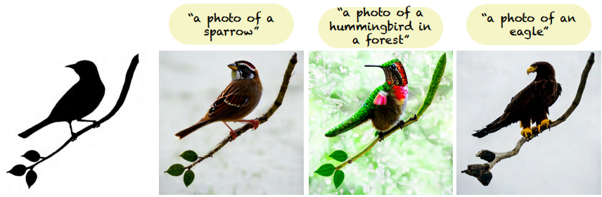
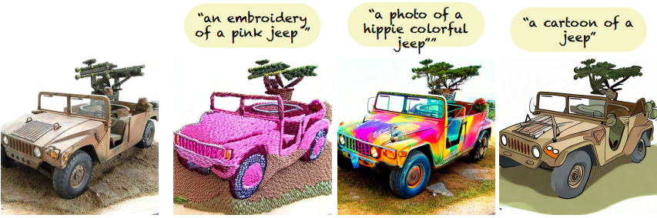
ID Preservation through Intermediate Features
No training or fine-tuning needed.
Intermediate features entangle identity with location and context, thus it requires additional work to allow for large changes in locations & contexts.
Directly overwrite denoiser features with target features $f$.
Plug-and-Play Diffusion Features for Text-Driven Image-to-Image Translation,
Tumanyan et al., CVPR 2023
Notes:
This form of identity preservation is used more often in the context of editing since it can easily be used to preserve as much of the input image as needed.
You can see that the results already show a form of image editing.
So lets continue with image editing methods next.

Slide 21
Editing with Generative Models
Personalization
Editing
ConsiStory: Training-Free Consistent Text-to-Image Generation
Tewel et al., ArXiv Feb. 2024
Diffusion Handles: Enabling 3D Edits for Diffusion Models by Lifting Activations to 3D Pandey et al., CVPR 2024
Motion Guidance: Diffusion-Based Image Editing with Differentiable Motion Estimators, Geng and Owens, ICLR 2024

Slide 22
Editing with Generative Models
Editing
Same subject, same scene.
Subject property changed by user edit.
(Property such as position, pose, etc.)
Editing:
Generative Model
+ Identity Preservation
+ Edit Control
Diffusion Handles: Enabling 3D Edits for Diffusion Models by Lifting Activations to 3D Pandey et al., CVPR 2024
Motion Guidance: Diffusion-Based Image Editing with Differentiable Motion Estimators, Geng and Owens, ICLR 2024

Slide 23
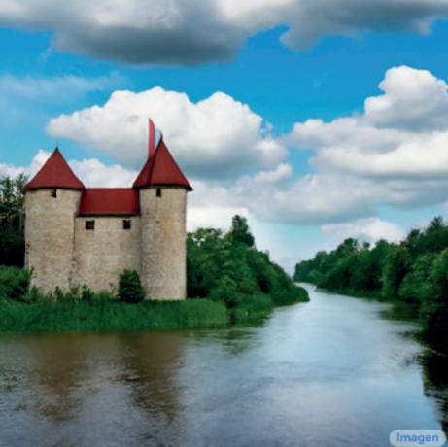
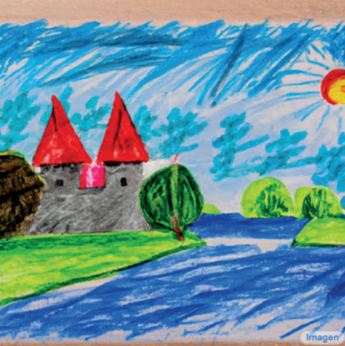


Image-to-Image Translation
Edit Control: Text Prompt
Identity Preservation: Condition Encoder
Large Paired Image Dataset
“Children drawing of
A castle next to a river.”
…
Condition Encoder
Weights $ψ$
Loss
Denoiser
Weights $θ$
InstructPix2Pix: Learning to Follow Image Editing Instructions,
Brooks et al., CVPR 2023
Palette: Image-to-Image Diffusion Models,
Saharia et al., SIGGRAPH 2022
Notes:
Identity preservation + simplest form of control: edited text prompt
(we may have seen some of this before in Danny’s talk)

Slide 24
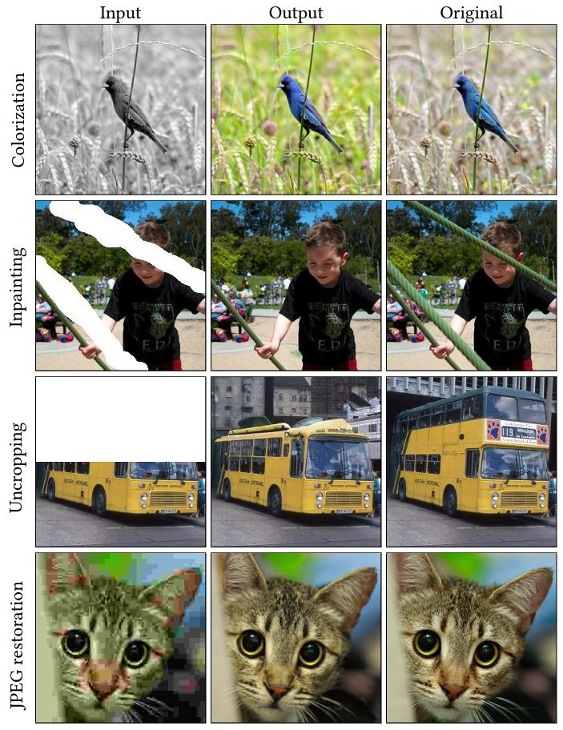
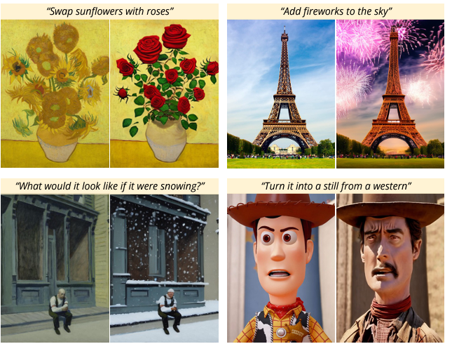
Image-to-Image Translation
Requires paired image dataset.
Text prompt provides only coarse control.
InstructPix2Pix: Learning to Follow Image Editing Instructions,
Brooks et al., CVPR 2023
Palette: Image-to-Image Diffusion Models,
Saharia et al., SIGGRAPH 2022
Notes:
InstructPix2Pix actually uses one of the editing approaches we describe next to generate the paired dataset.

Slide 25

Image-to-Image Translation
“A castle next to a river.”
Edit Control:
Text Prompt
Identity Preservation:
Intermediate Features / Attention Maps
Denoiser
same noise
Intermediate Features $f$
or Attention Maps $A$
Denoiser
“Children drawing of
A castle next to a river.”
Plug-and-Play Diffusion Features for Text-Driven Image-to-Image Translation,
Tumanyan et al., CVPR 2023
Prompt-to-Prompt Image Editing with Cross Attention Control,
Hertz et al., ArXiv Aug. 2022
MasaCtrl: Tuning-Free Mutual Self-Attention Control for Consistent Image Synthesis and Editing, Cao et al., ArXiv Aug. 2022
Notes:
Identity preservation + simplest form of control: edited text prompt
(we may have seen some of this before in Danny’s talk)

Slide 26
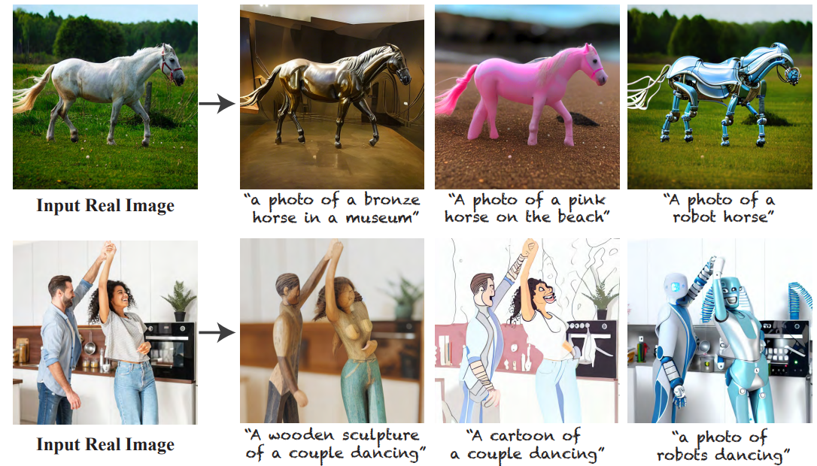
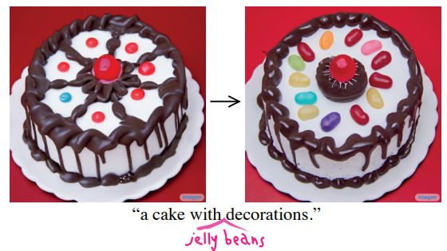

Image-to-Image Translation
No training or fine-tuning needed.
Cannot strongly change scene layout (object positions in the image remain roughly the same)
Text prompt provides only coarse control.
Plug-and-Play Diffusion Features for Text-Driven Image-to-Image Translation,
Tumanyan et al., CVPR 2023
Prompt-to-Prompt Image Editing with Cross Attention Control,
Hertz et al., ArXiv Aug. 2022

Slide 27

Image-to-Image Translation
No training or fine-tuning needed.
Cannot strongly change scene layout (object positions in the image remain roughly the same)
Text prompt provides only coarse control.
MasaCtrl: Tuning-Free Mutual Self-Attention Control for Consistent Image Synthesis and Editing, Cao et al., ICCV 2023

Slide 28


Editing with Attention Maps and Intermediate Features
Edit Control: Transform Intermediate Features / Attention Maps
Identity Preservation: Intermediate Features / Attention Maps
“a furry bear watching a bird”
Attention maps
from pixels
to text tokens.
Denoiser
Prompt-to-Prompt Image Editing with Cross Attention Control,
Hertz et al., ArXiv Aug. 2022
Diffusion Self-Guidance for Controllable Image Generation,
Epstein et al., NeurIPS 2023
Diffusion Handles Enabling 3D Edits for Diffusion Models by Lifting Activations to 3D, CVPR 2024
Notes:
Control by editing Attention Maps.
(we may have seen this before in Danny’s talk)

Slide 29
Editing with Attention Maps and Intermediate Features
“a furry bear watching a bird”
Edit Control:
Transform Intermediate Feat. / Att. Maps
Identity Preservation:
Intermediate Features / Attention Maps
Denoiser
Intensity:
Make the bear more furry:
Increase intensity of the
corresponding attention map.
same noise
Intermediate Features $f$
or Attention Maps $A$
Location:
Move the bear:
Move the corresponding
attention map and intermediate features.
Denoiser
Prompt-to-Prompt Image Editing with Cross Attention Control,
Hertz et al., ArXiv Aug. 2022
Diffusion Self-Guidance for Controllable Image Generation,
Epstein et al., NeurIPS 2023
Diffusion Handles Enabling 3D Edits for Diffusion Models by Lifting Activations to 3D, CVPR 2024
“a furry bear watching a bird”
Notes:
Identity preservation uses intermediate features and attention maps, as discussed before.
We can control the location and intensity of objects the concepts and objects that appear in the prompt.

Slide 30


Editing with Attention Maps and Intermediate Features
Prompt-to-Prompt Image Editing with Cross Attention Control,
Hertz et al., ArXiv Aug. 2022

Slide 31


Editing with Attention Maps and Intermediate Features
Diffusion Self-Guidance for Controllable Image Generation,
Epstein et al., NeurIPS 2023
Notes:
Identity preservation + simplest form of control: edited text prompt
(we may have seen this before in Danny’s talk)

Slide 32

Editing with Attention Maps and Intermediate Features
Attention maps / intermediate features can be 3D-transformed using monocular depth estimates.
Diffusion Handles Enabling 3D Edits for Diffusion Models by Lifting Activations to 3D, CVPR 2024

Slide 33

Editing with Attention Maps and Intermediate Features
Attention maps / intermediate features can be 3D-transformed using monocular depth estimates.
Diffusion Handles Enabling 3D Edits for Diffusion Models by Lifting Activations to 3D, CVPR 2024

Slide 34
Editing with Optical Flow Guidance
Edit Control: Optical Flow from Source to Target
Identity Preservation: Match colors.

Slide 35



Identity Preservation
Per-instance fine-tuning
Per-subject fine-tuning
General fine-tuning
How can we represent the identity of a subject?
Without changing the denoiser architecture,
these are some approaches that have been used:
Training-free
How can we represent the identity of a subject?
With a fine-tuned text embedding.
With fine-tuned denoiser weights.
With intermediate denoiser features.
With features obtained from a specialized encoder.
1) Text Embeddings $y$
Denoiser
2) Weights $θ$
3) Intermediate Features $f$

Slide 36
Low-Rank Adaption (LoRA)
LoRA: Low-Rank Adaptation of Large Language Models, Hu et al., ICLR 2022

Slide 37
ID Preservation using LORA
Mix-of-Show: Decentralized Low-Rank Adaptation for Multi-Concept Customization of Diffusion Models, Gu et al., NeurIPS 2023
LoRA-Composer: Leveraging Low-Rank Adaptation for Multi-Concept Customization in Training-Free Diffusion Models, Yang et al., ArXiv March 2024

Slide 38
ID Preservation with Multiple Subjects

