Slide 1
Guidance & Diffusion Models
Duygu Ceylan

Slide 2
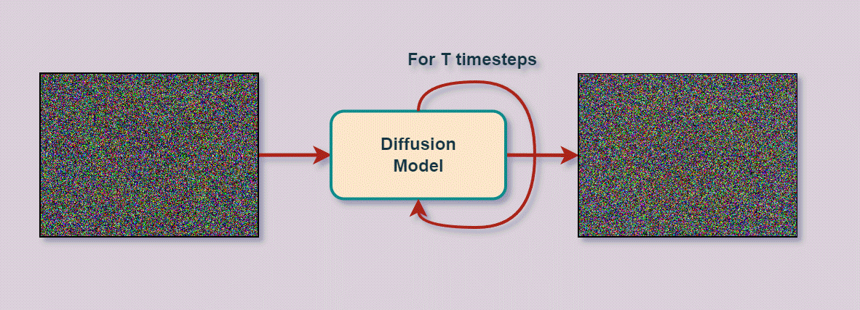
Diffusion models in a nutshell
self
attention
Q K
V
Q K
V
cross
attention
conditioning signal (e.g., text)
https://learnopencv.com/image-generation-using-diffusion-models/
Notes:
Without going into much detail, one of the core foundations of this transformation is the success of image diffusion models. Withough going into too much detail, diffusion models are probablistic generation models that thurn noise samples into representative data samples, in case of image generation, to natural images. Furthermore, a popular architecture in diffusion models is a Unet architecture which often consists of self attention and cross attention blocks. While the self attention layers are known to encode information about the structure and the apperance of the image, the cross attention layers often model conditioning with respect to input signals such as text.

Slide 3
Classifier Guidance

Slide 4
Classifier-free Guidance

Slide 5
Different conditioning signals
self
attention
Q K
V
Q K
V
cross
attention
Repurposing existing layers with new signals

Slide 6
Different conditioning signals
self
attention
Q K
V
Q K
V
Q K
V
new cross
attention
Additional signals

Slide 7
Other conditioning methods
ControlNet

Slide 8
Other conditioning methods
IPAdaptor

