Slide 1


Diffusion Models for Visual Computing
Niloy J. Mitra

Slide 2
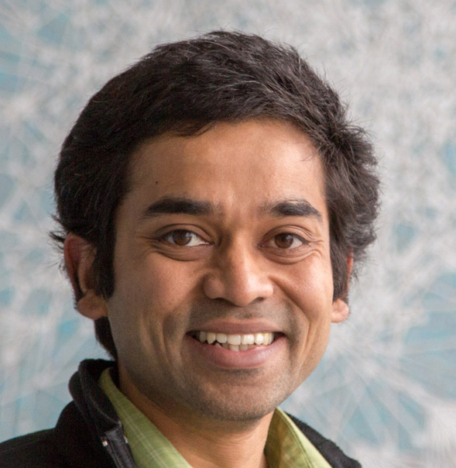
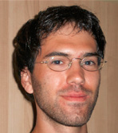
Introduction from the authors
Niloy Mitra
Duygu Ceylan
Daniel Cohen-Or
ChunHao Huang
Paul Guerrero
Minhyuk Sung

Slide 3
Why do we need this Tutorial?

Slide 4
Presentation Schedule
Introduction to Diffusion Models
Guidance and Conditioning Sampling
Attention
Break
Personalization and Editing
Beyond RGB Images
Diffusion Models for 3D Generation

Slide 5
Applications

Slide 6



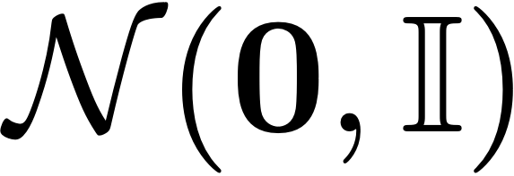
Mapping between Distributions
data
distribution
known
distribution

Slide 7
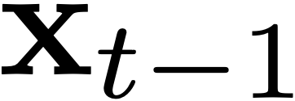
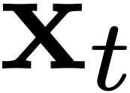
Mapping in Many Steps
forward mapping
$$q(x_{t}|x_{t−1})=𝒩(x_{t};\sqrt{α_{t}}x_{t−1},(1−α_{t})𝕀)$$

Slide 8
Mapping in Many Steps
forward mapping
$$q(x_{t}|x_{t−1})=𝒩(x_{t};\sqrt{α_{t}}x_{t−1},(1−α_{t})𝕀)$$

Slide 9

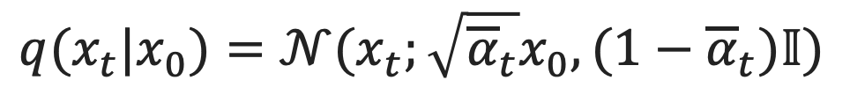
Mapping in Many Steps
forward mapping
$$q(x_{t}|x_{t−1})=𝒩(x_{t};\sqrt{α_{t}}x_{t−1},(1−α_{t})𝕀)$$
$$q(x_{t}|x_{0})=𝒩(x_{t};\sqrt{{\overline{α}}_{t}}x_{0},(1−{\overline{α}}_{t})𝕀)$$
$${\overline{α}}_{t}=Π_{i=1}^{t}α_{i}$$

Slide 10
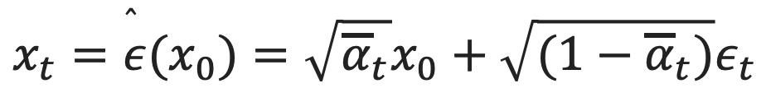
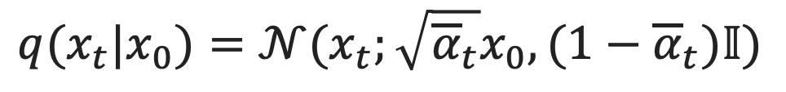
Mapping in Many Steps
forward mapping
$$q(x_{t}|x_{0})=𝒩(x_{t};\sqrt{{\overline{α}}_{t}}x_{0},(1−{\overline{α}}_{t})𝕀)$$
$$x_{t}=\overset{̂}{ε}(x_{0})=\sqrt{{\overline{α}}_{t}}x_{0}+\sqrt{(1−{\overline{α}}_{t})}ε_{t}$$

Slide 11
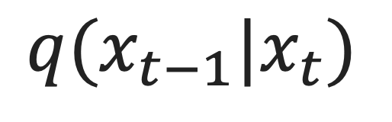
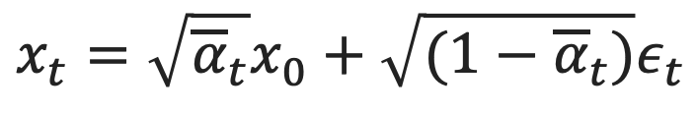

Generative Modeling: Sampling
reverse mapping
$$q(x_{t−1}|x_{t})$$
$$x_{t}=\sqrt{{\overline{α}}_{t}}x_{0}+\sqrt{(1−{\overline{α}}_{t})}ε_{t}$$
$$≈$$
$$p(x_{t−1}|x_{t})=𝒩(x_{t−1};\sqrt{{\overline{α}}_{t−1}}D_{θ}(x_{t},t),(1−{\overline{α}}_{t−1})𝕀)$$

Slide 12
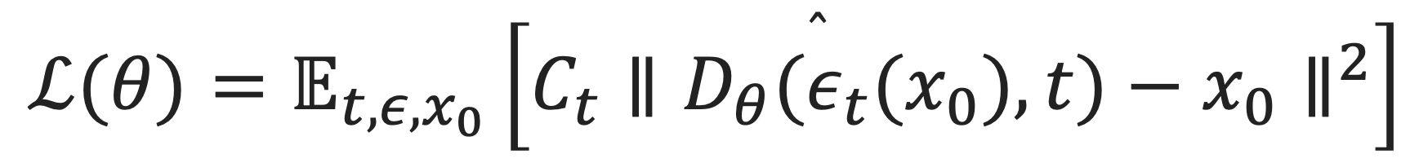
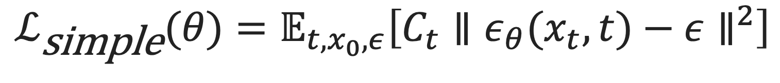
Loss Functions
$$ℒ_{\text{simple}}(θ)=𝔼_{t,x_{0},ε}\left[C_{t}∥ε_{θ}(x_{t},t)−ε∥^{2}\right]$$
$$ℒ(θ)=𝔼_{t,ε,x_{0}}\left[C_{t}∥D_{θ}({\overset{̂}{ε}}_{t}(x_{0}),t)−x_{0}∥^{2}\right]$$
$$p(x_{t−1}|x_{t})=𝒩(x_{t−1};\sqrt{{\overline{α}}_{t−1}}D_{θ}(x_{t},t),(1−{\overline{α}}_{t−1})𝕀)$$

Slide 13
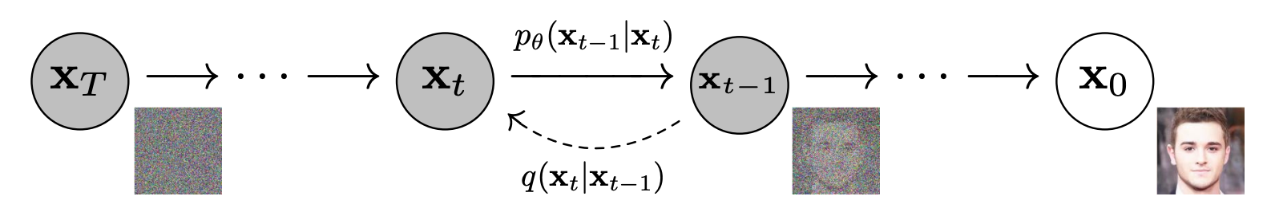
What Are Diffusion Models?
reverse process (learnt denoiser)
forward process (no learnable parameters)
Notes:
Dimension of signal
Markov chain
Gaussian noise

Slide 14
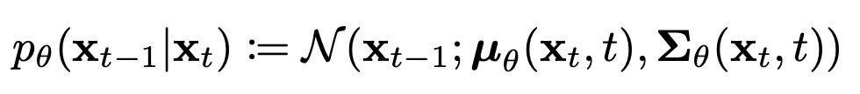

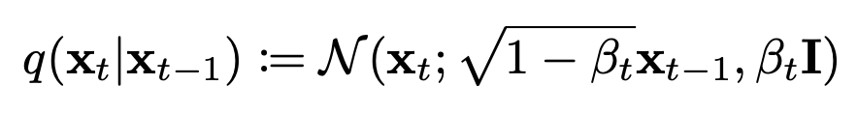

What Are Diffusion Models?
reverse process (learned)
forward process (fixed/deterministic)

Slide 15
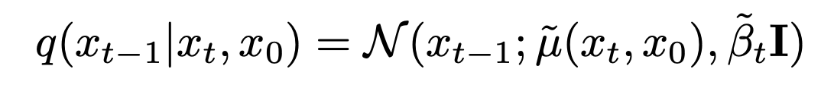
Diffusion Models (cont.)

Slide 16
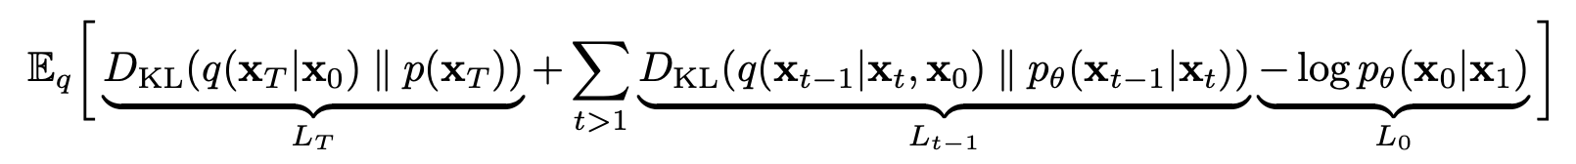


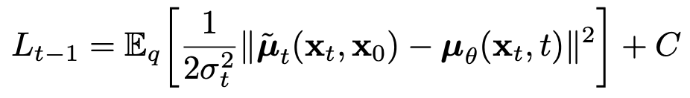
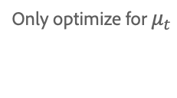
How are They Trained?
Only optimize for $μ_{t}$

Slide 17
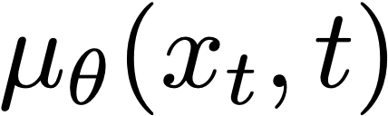
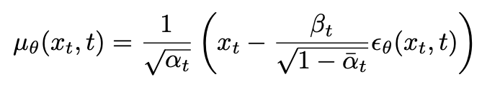
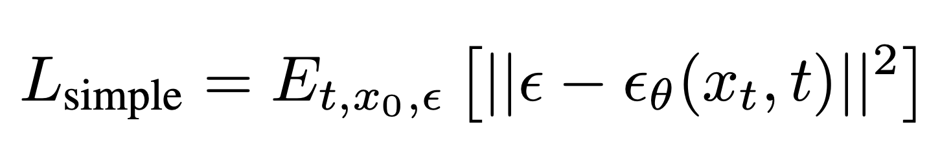

Different Parameterizations
1. Directly predict $μ_{θ}(x_{t},t)$
2. Predict $ε$

Slide 18
DDIM

Slide 19
CLIP

Slide 20
Latent Diffusion (StableDiffusion)

Slide 21
LoRA

Slide 22
ControlNet

